Slide 1

User Guide Network Scale Compute

Slide 2

Prerequisites
Knowledge and Experience-related prerequisites
Have knowledge of carrying out data analytics using Bigdata analytic software
Possess basic knowledge of cloud-native applications, Docker, and Kubernetes
Have hands-on experience in using basic Linux commands
Access-related prerequisites
Ensure that your AD account is UNIX-enabled in the IDM portal.
Create a group for your project in the IDM portal.
Add yourself to a project group in the IDM portal.
Request for adding the new project group to NSC or adding you to an existing NSC project group, in the My Support & Services portal.
For more information, please read the Onboarding NSC users blog.

Slide 3
Objectives
This user guide will enable you to:
Explain the NSC platform and its functionalities
Deploy and monitor services and volumes for your analytical activities, as a User
Facilitate User activities by performing administration activities in NSC, as a Group Administrator

Slide 4
Instructions
View the presentation in the slide show mode only; the slideshow mode will give you better visibility to the text and help you access the hyperlinks easily.
Use this guide starting from the Content slide (next slide). The Content slide contains hyperlinks to all other slides in the presentation.
Click the underlined text in the userguide to learn more about the text.
Go through all the slides in the first section Getting Started with NSC to familiarize yourself with NSC, which will help you understand the content of other slides.
The term “Users” in this user guide refers to users of a project group in the NSC platform.
The term “NSC Users” refers to all the users of the NSC platform such as Users and Group Administrators.

Slide 5
To navigate to the desired page, press the F5 button and click the desired topic. From any slide, you can get back to this slide by clicking:
A step-by-step guide to NSC
Back to index
Getting Started with NSC | NSC Overview Business Objectives of NSC Key Terms and Activities | NSC Platform Offerings Roles and Responsibilities | NSC Platform Environment How to Log On
Using NSC Platform Services |  | Administering NSC Platform
Services Deploy an Existing Service Deploy a Custom Service Ingest Data | Deployments Create Deployment Replicas Monitor Deployments View Usage and Alerts Access the Deployed Container Authenticate yourself to execute Kubectl commands Access Volumes | User Management Add User Groups Deployments Add Volumes Edit and Share Volumes Deploy Helm charts from CLI Add Environments Add Namespaces Add PVCs within a Namespace | Services Add a Custom Service Configure Images for a Custom Service Create a Manifest file to Add a Custom Service Create Helm Charts to Add a Custom Service
FAQs | Appendix NSC Generic Service Offerings Generic Service Offerings Certification Checklist Third Party Components in NSC General Instructions for Deployment |  | Help and Support
Glossary
The sequence of topics displayed in this slide may differ from that in the presentation. This is because, in this slide, the slides are placed under appropriate categories to enable you to locate the desired topic. To view the exact sequence of topics in a section, refer to the section objectives of the respective section.

Slide 6
Getting Started with NSC

Slide 7
Section objectives
This section is intended for all users (Users and Group Administrators) of the NSC platform to familiarize themselves with the fundamentals of the NSC platform.
At the end of this section, you will be able to:
Explain the need for the NSC platform
List the business objectives of the NSC platform
Describe the key terms and activities related to NSC
List the key offerings of the NSC platform
List the key user roles in the NSC platform and describe their responsibilities
Describe the key features in the NSC platform environment
Explain the procedure to log on to the NSC platform
Back to index

Slide 8
Overview
The Need
Traditionally, the models for on-premises deployment of analytics infrastructure has been single dedicated bare metal clusters with direct-attached storage, aiming to serve many users and use-cases. However, as enterprises grow their on-premises analytics infrastructure, they often find themselves deploying multiple clusters, with multiple dedicated bare-metal clusters to support a wide variety of use-cases and new versions of new innovative frameworks. This very quickly becomes both complex and expensive.
The Solution
Therefore, a cloud-operating model of self-service and elasticity is compelling to many enterprises, not least for analytics and machine intelligence. Such a model could provide a flexible infrastructure to build and deploy data-intensive, cloud-native enterprise applications faster, by eliminating the complexity and slowness associated with managing servers, storage and networks for distributed applications, big data processing, databases and more. The advantages of such a model are operational efficiency, flexibility and agility, with performance comparable to bare-metal clusters.
NSC as a solution
NSC is a cloud-based managed environment for deploying containerized applications. It comes with a high performance general file-, block-, and object-storage infrastructure for distributed processing and data storage with centralized governance, Role-Based Access Control (RBAC) support, Single Sign-On (SSO) integration, multi-tenancy and a wide range of analytics and machine intelligence applications.
On-demand access to analytical applications is made possible using containerization of applications. Docker is the software used to create containers and Kubernetes is the container management platform used to deploy containers automatically for applications.
Back to index

Slide 9
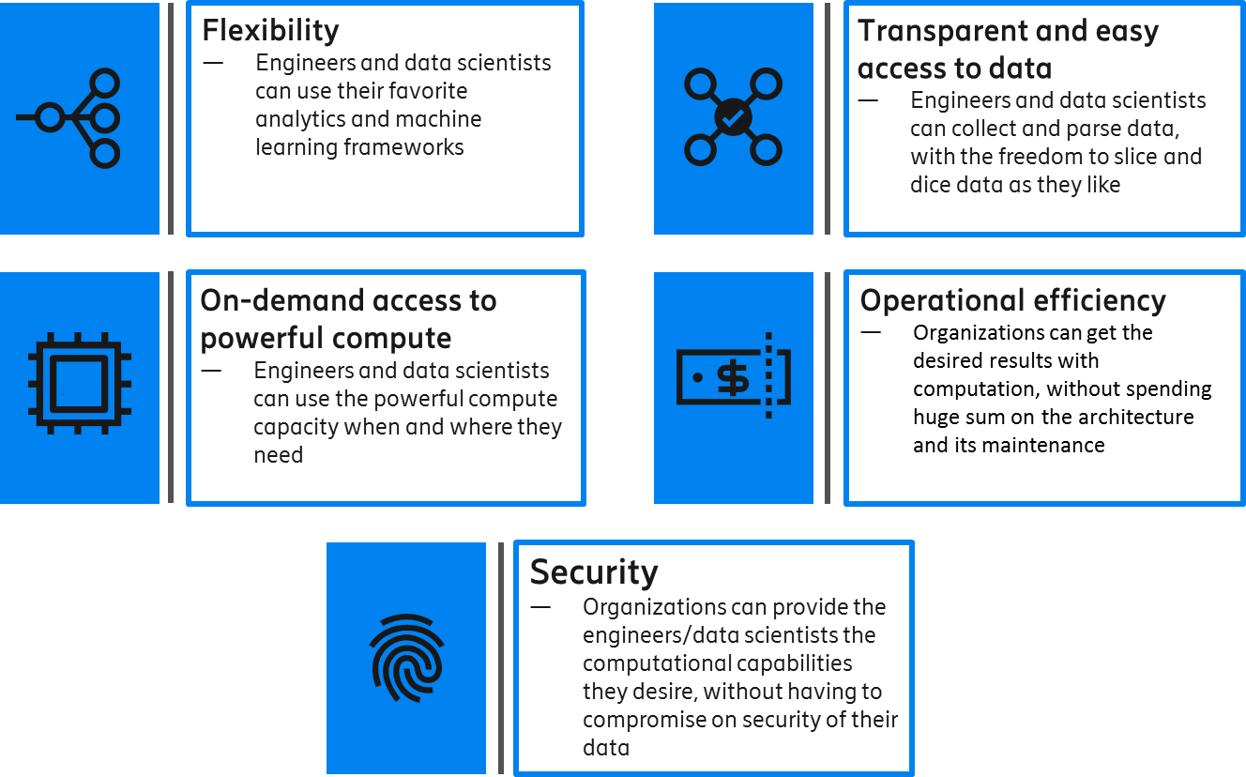
Business objectives
The NSC platform has been designed to cater to the key demands of engineers and data scientists without compromising on the cost and security aspects that organizations desire.
Back to index

Slide 10
Key terms and activities
To understand how to deploy, administer, manage, and monitor services in NSC, you need to familiarize yourself with key terms and activities related to service deployment. These are presented below in a sequence to help you understand the technologies behind NSC:
NSC is a platform that provides you capabilities to perform analytical activities on your data.
Analytical activities are carried out using software applications.
Applications that perform such activities are executed on the NSC platform by deploying containers.
Containers are running instances of container images.
A container image packages an application and the associated system libraries it depends on. This ensures that the application can remain independent of the environment, infrastructure, and configuration and can be managed easily.
A collection of container images is stored in registries such as Docker Hub.
Management of containers is done by Kubernetes, a container management platform, which helps you run analytical workloads on your data.
Data present in a variety of data sources are accessed from a single computer cluster using the software, MapR.
MapR includes MapR-File System (FS) that allows containerized applications to concurrently read and write directly to disks.
Back to index

Slide 11
NSC platform features
The NSC platform caters for your analytical needs such as applications and storage. The following are NSC platform offerings.
NSC Platform features
In-built service catalog (Eg: Spark, Postgres)
Ability to upload own application catalog
Docker registry to run uploaded applications
Ability to deploy in-built/custom service
Persistent storage in the event of hardware failure
Back to index

Slide 12
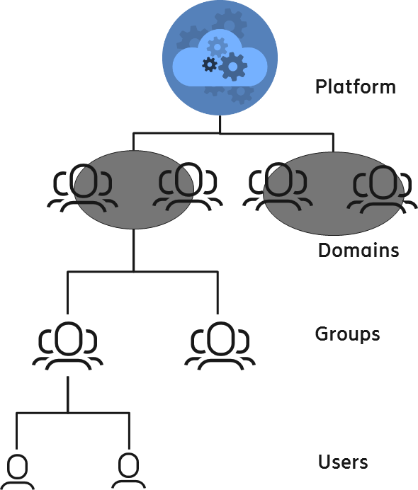
Roles and responsibilities
Access to NSC assets is organized as domains and groups. Two or more users having a common goal or belonging to a project form a group. Multiple groups collectively form a domain. All platform resources are owned by a group.
Domain Administrators
Are responsible for managing a domain of groups, users, data storage, computer resources, and applications.
Are responsible for the group-wide delegation of authority to the Group Administrators.
Group Administrators
Are responsible for managing a group (organisation and/or project) of users, quota of data storage (data volumes) and compute resources, and access to applications.
Can share the group quota of data storage and compute resources with all the users belonging to the same group.
Users
Can access compute resources and data storage (in the form of volumes) assigned to or shared with them.
A user can belong to only one group. A group (of users and virtual compute and storage resources) can belong to only one domain.
Back to index

Slide 13
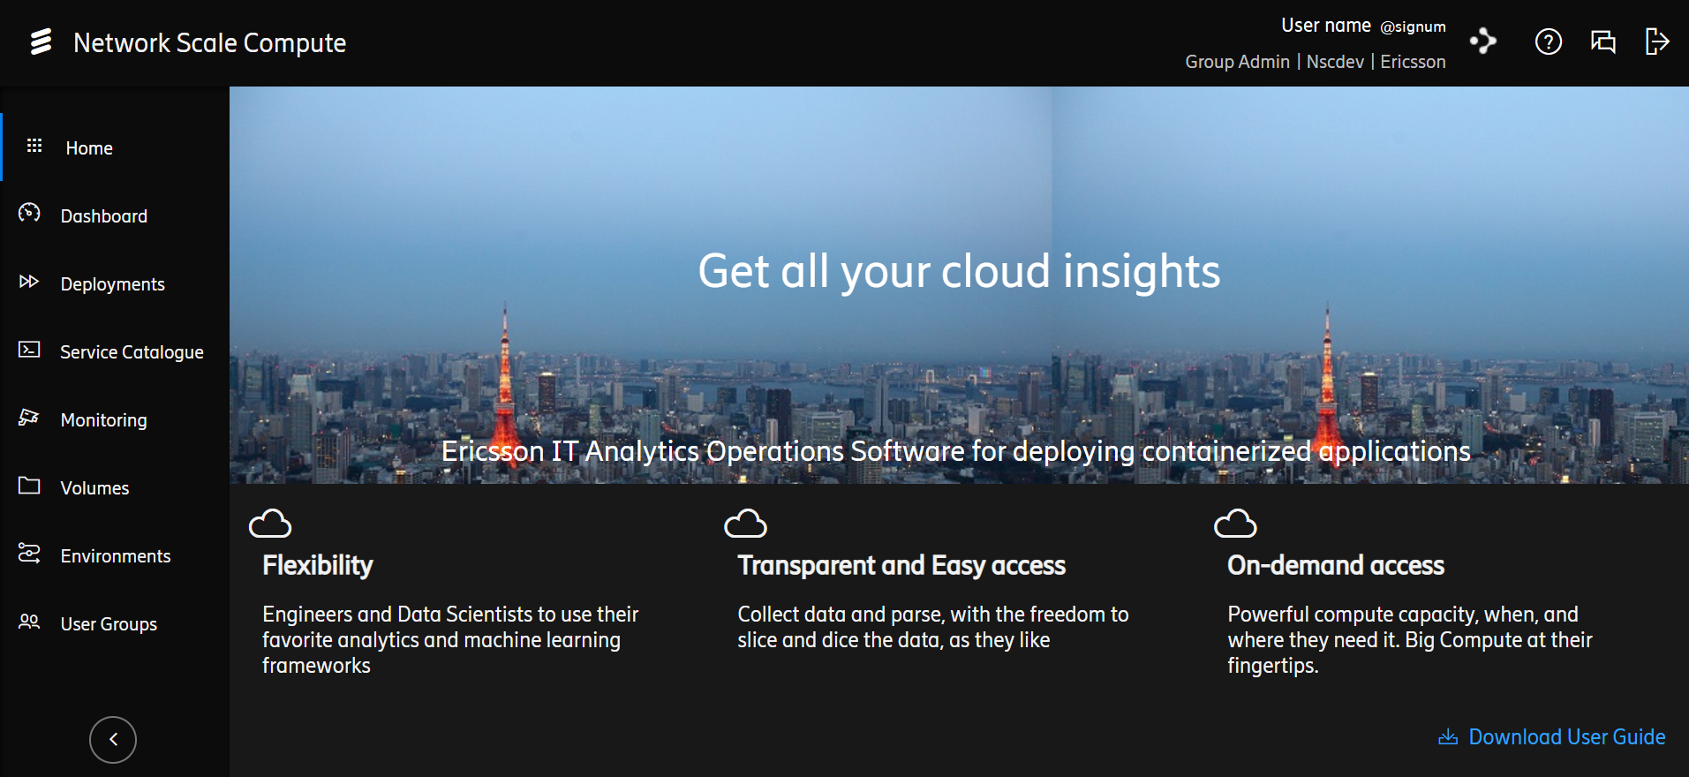
NSC platform environment
As a User/Group Administrator, you can perform your tasks through various options on the left menu on the home screen, as indicated below.
Sign out from the NSC platform.
1
View details of the logged in user.
2
3
4
5
6
7
8
Download the user guide.
1
2
3
4
Access all services using links.
View your and your group’s usage details such as CPU and RAM used and alerts about usage.
View deployment details such as which services have been deployed and when.
View and deploy generic services available to all or group-specific services.
Tabs 5-8 are explained on the next slide.
Back to index

Slide 14
NSC platform environment (contd.)
As a User/Group Administrator, you can perform your tasks through various options on the left menu on the home screen, as indicated below.
1
2
3
4
5
6
7
8
5
6
7
8
Monitor usage details of CPU, memory, and file system.
Access and manage volumes you are using.
Create environments and the associated resources such as namespaces and PVCs.
Create and delete User Groups.
The User Groups tab on the left menu will be visible only to Group Administrators.
Back to index

Slide 15
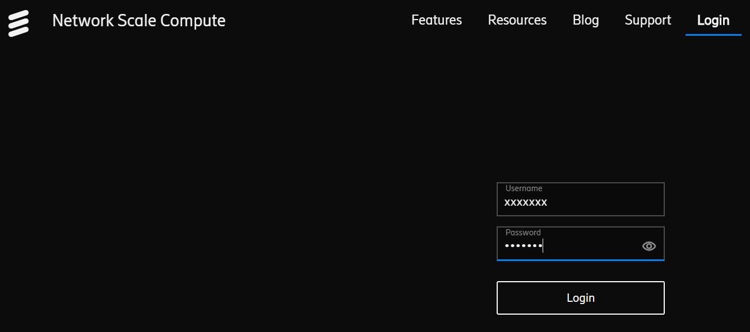
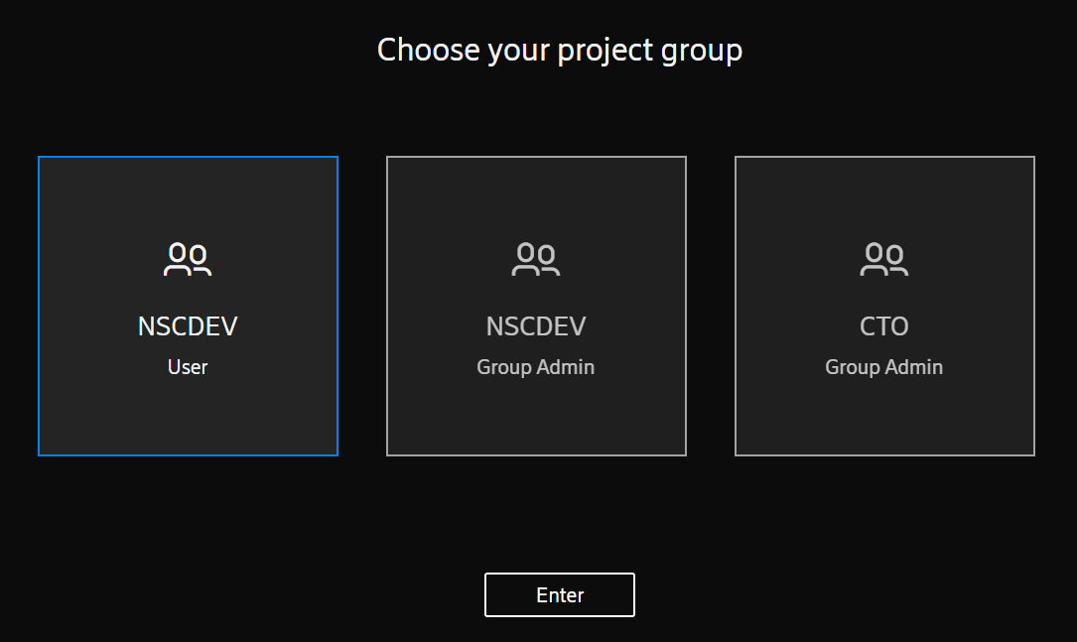
How to log on
In your browser, enter the link https://nsc.infra.ericsson.se/.
Enter your user credentials (SIGNUM ID and password) and click Login.
If you are part of multiple groups and you have different access roles in the groups, then choose the group and role and click Enter.
Before you log on, ensure that you have access to the NSC platform. If you don’t have access to the platform, please follow the onboarding process to obtain access.
Back to index

Slide 16
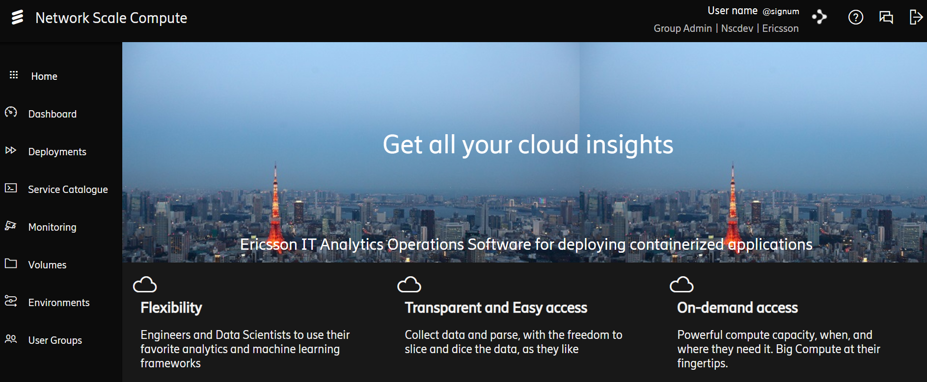
How to log on (contd.)
The Home page of the NSC platform opens.
The tabs available on the left menu depends on the role you chose when you logged on to the platform.
Back to index

Slide 17
Using NSC Platform Services

Slide 18
Section objectives
This section is intended for NSC Users and Group Administrators.
At the end of this section, you will be able to:
Deploy an existing service
Deploy a custom service
Create replicas of deployments
Monitor your deployments
View your resource usage and alerts
Access the deployed container
Access the volumes that have been assigned to you or shared with you
Ingest data into the NSC platform
Back to index

Slide 19
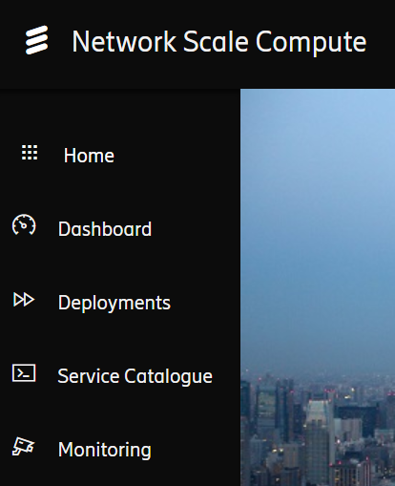
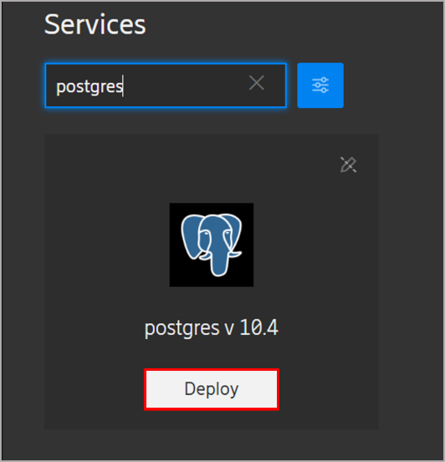
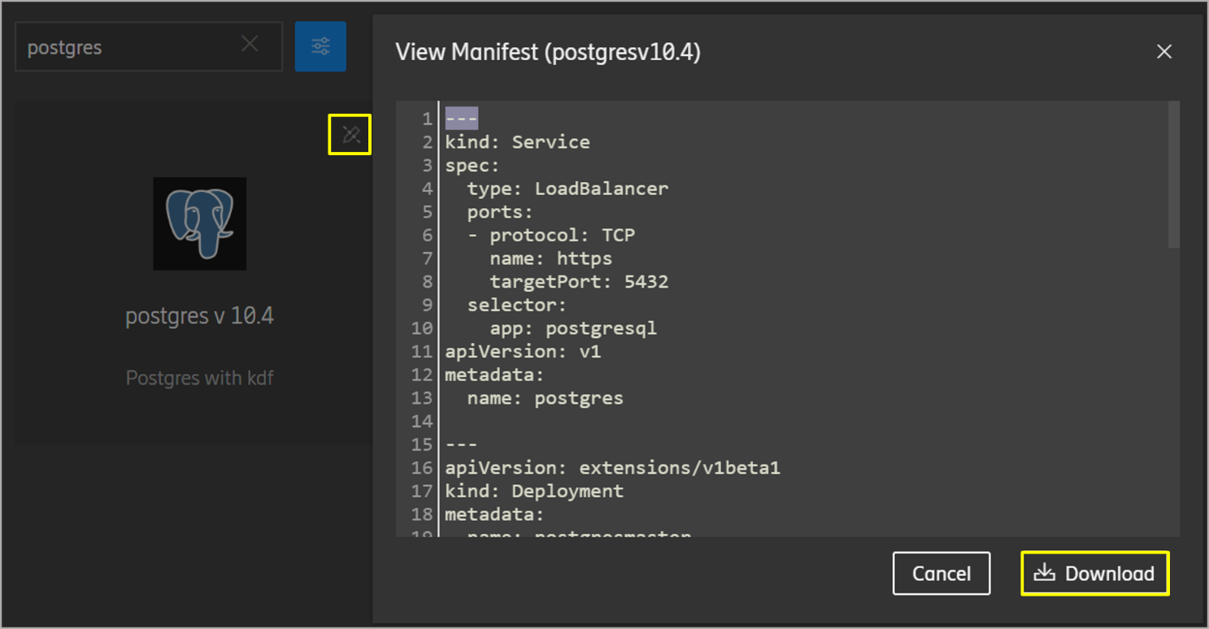
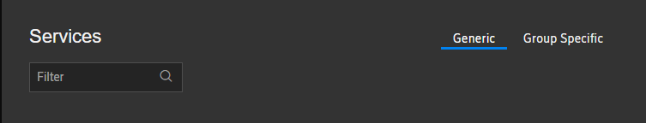
Deploy an existing service
NSC provides a catalog of services that you can readily deploy for your needs. The following steps will help you deploy an existing service.
Log on to the NSC platform as a User / Group Administrator.
Navigate to the Service Catalogue tab on the left menu.
Select Generic from the top pane.
The Generic tab displays services that are available to users of all the groups; whereas, the Group Specific tab enables you to deploy services that are available only to your group. To view the NSC generic services list, refer to the slide NSC Generic Service Offerings.
Place your mouse over the required service to view the Deploy button. Then, click Deploy.
To view a service’s manifest file, click the View Manifest button (shown below) on the top-right corner of the service. You may also download the manifest file, if required.
Back to index

Slide 20
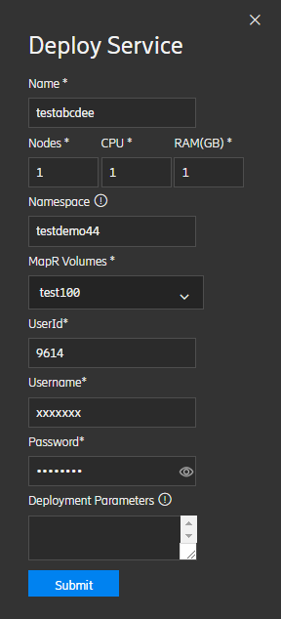
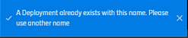
Deploy an existing service (contd.)
Enter the required details and click Submit.
Enter a Name appropriate for the service deployment.
In the Nodes field, enter the number of nodes required. This includes master nodes for cluster based services (Eg: Spark) and includes only the server nodes for standalone services (Ex: Postgres).
Enter the number of CPU (Virtual CPUs) required.
Enter the required RAM (in GB).
Enter the preferred Namespace. Namespace should start and end with alphanumeric characters and can contain alphanumeric characters and hyphen (-).
The Name and Namespace should be unique for every deployment. If the name/namespace of your deployment is same as that of an existing deployment, a message indicating the same will be displayed.
Select the MapR volume you want to mount.
In the UserId field, enter your Global Unix AD account ID.
In the Username field, enter your SIGNUM ID.
In the Password field, enter your SIGNUM password.
The values in the fields UserId, Username and Password will be used for authenticating MapR volume mount.
For the SFTP and RStack services, you will find an additional field Service Password. You may enter any desired value in this field. You can use your ESIGNUM and the service password entered here, to access the SFTP or the RStack service.
☞
Please move to the next slide to learn about deployment parameters.
Back to index

Slide 21
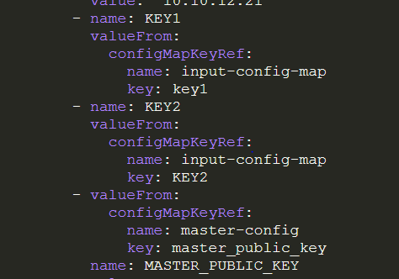
Deploy an Existing Service (Contd.)
Enter the required details and click Submit.
In the Deployment Parameters field, enter the parameters that you want to use in container pods. Use the following format to specify the deployment parameters.
{“key1”:”value1”, “KEY2”:”VALUE2”}
The deployments parameters are accessible as environment variables inside pods and should be a valid
The variables initialized as deployment parameters will be accessed using Kubernetes configmap. The number of
parameters passed as deployment parameters will be defined in the manifest file as shown below. Ensure that you mention
the config map’s name as input-config-map (shown below), when you define a deployment parameter in the
manifest file.
JSON.
JavaScript Object Notation (JSON) is a format to transmit data between a server and a web application.
Back to index

Slide 22
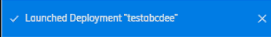
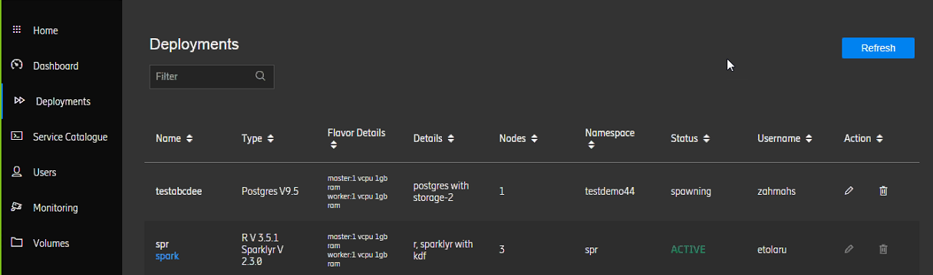
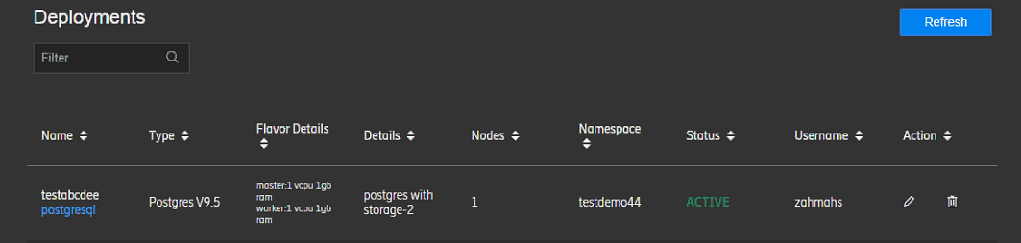
Deploy an existing service (contd.)
Once the deployment is launched, a message indicating successful deployment is displayed.
Navigate to the Deployments tab and view the deployment details. If the Status of the deployment is Pending or Spawning, click Refresh to view the updated status.
Once the deployment is complete, the Status changes to ACTIVE. The server link appears below the service name in the Name column.
Instead of the server link, if the word Deploying appears below the service name, then wait for sometime or click Refresh to check if the deployment is complete. If deployment is not successful even after some time (~10 minutes), write a mail to nsc.team@ericsson.com.
Back to index

Slide 23
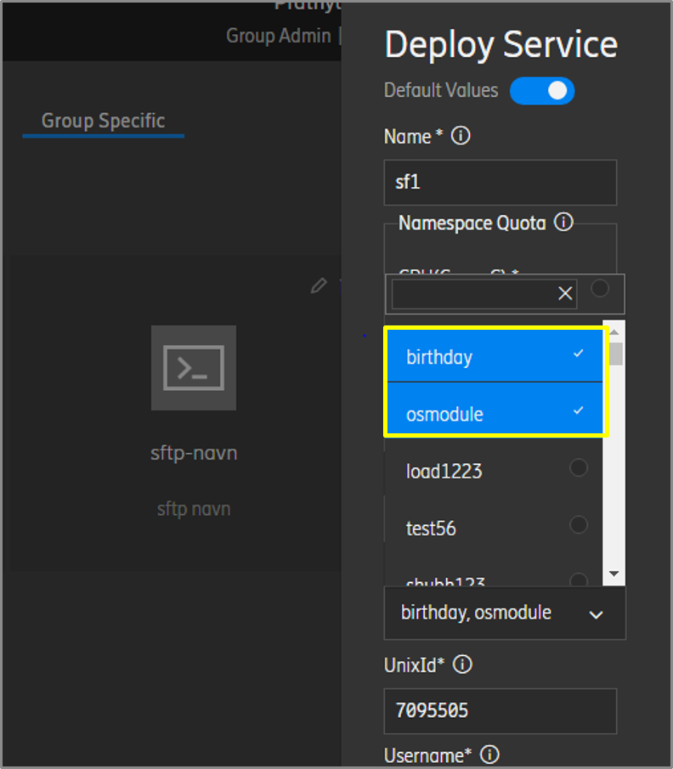
Deploying a custom service
To deploy a custom service, the custom service should be added to the NSC platform. Contact your Group Administrator to add a custom service under the Group Specific Services category.
The procedure for deploying a custom service is the same as used when deploying an existing service. However, while deploying a group-specific service, you have the flexibility to choose one or more volumes in the MapR Volumes field. This feature is particularly useful when your data is stored in multiple volumes. To learn more about this feature and also how to access multiple persistent volumes, please read our blog Freedom to use multiple volumes for custom services
To know your Group Administrator, view the attached Excel sheet in the My Support knowledge article.
If you are a group administrator, refer to the slide Add a Custom Service to learn how to add a service to the NSC platform.
Back to index

Slide 24
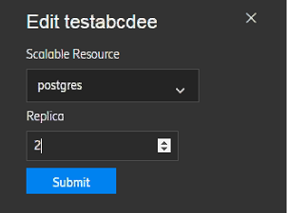
Create deployment replicas
You can create any number of replicas of a service deployed, from the Deployments tab. The following steps will help you create replicas of your deployment.
On the Deployments tab, corresponding to the required deployment, click the Edit button.
Only Active deployments can be replicated.
In the Edit <Deployment> section, select the Scalable Resource and the number of replicas you want to create. Click Submit.
Back to index

Slide 25
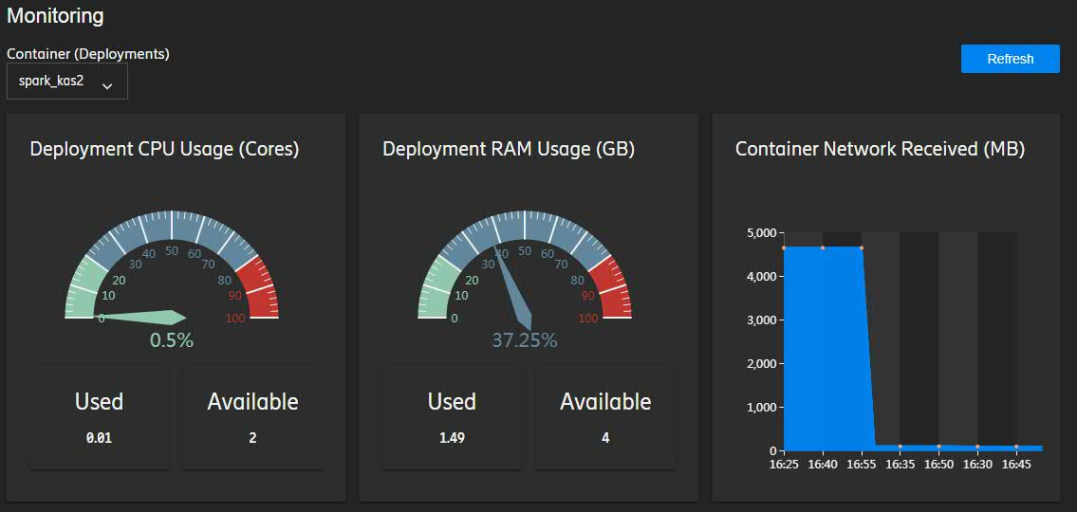
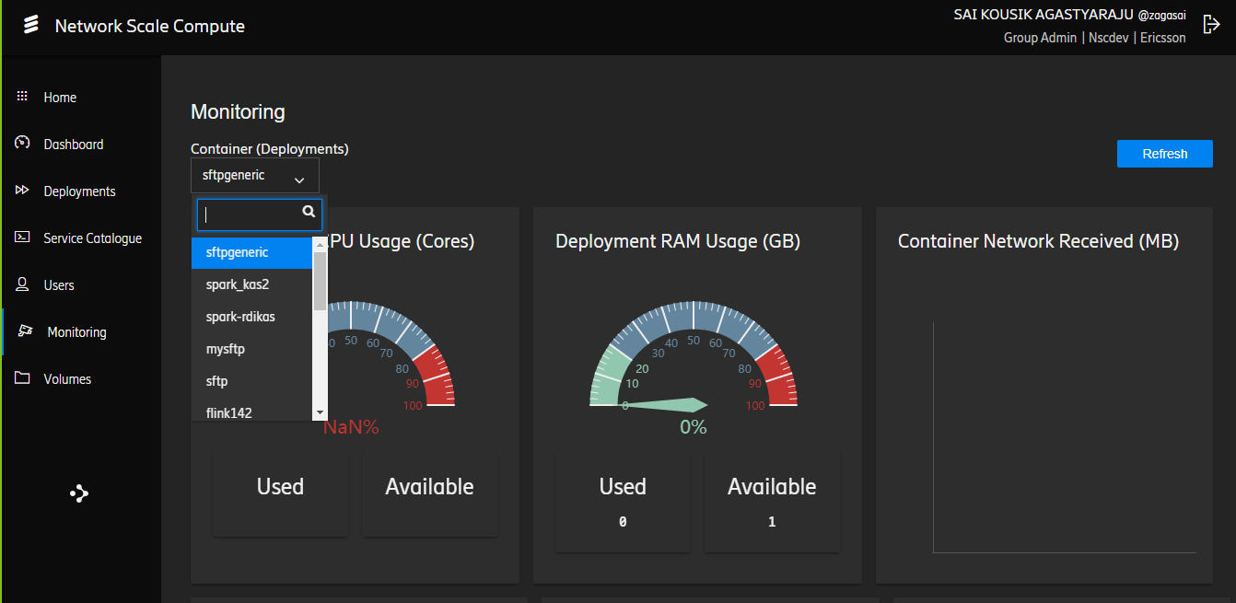
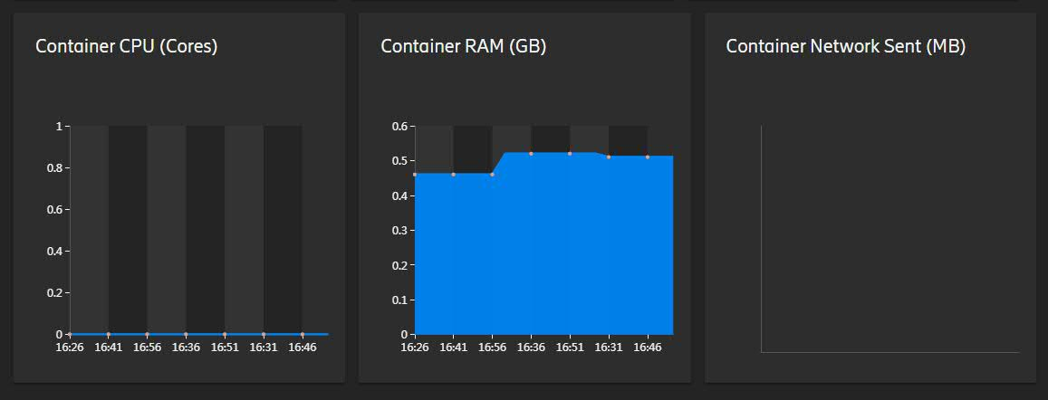
Monitoring deployments
NSC enables you to monitor your deployments. You can monitor only those deployments that you or your group members have made.
Click the Monitoring tab on the left menu.
From the Container (Deployments) drop-down menu, select the required deployment to monitor.
View the usage details of CPU and RAM .
Back to index

Slide 26
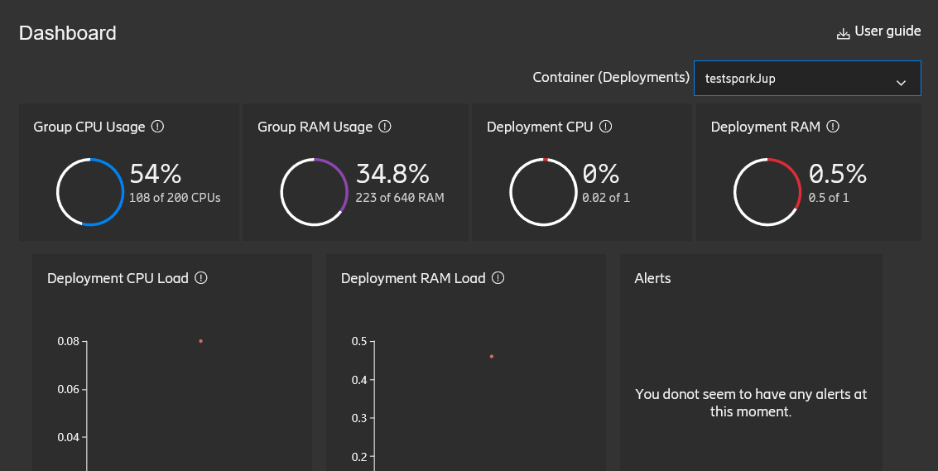
View usage and alerts
The NSC platform, through its dashboard, allows you to view the usage of resources in your deployments and alerts generated about resource utilization with respect to the usage limit.
Navigate to the Dashboard tab on the left menu.
The utilization of resources such as RAM and CPU, along with their graphical representations, are displayed on the dashboard .
If you have logged on to the platform as a Group Administrator, you will be able to view the utilization of resources in the deployments that you and your group members have made.
Resource utilization
Usage limit alerts
Graphical representation of resource utilization

Slide 27
Accessing a deployed container
You may want to access a deployed container to check the service you deployed. You can access the container pods from a Windows or Linux machine. The following steps show how,from a Windows machine.
From Windows PowerShell,
Install chacos package manager using the following command.
# Set-ExecutionPolicy Bypass -Scope Process -Force; iex ((New-Object
System.Net.WebClient).DownloadString('https://chocolatey.org/install.ps1'))
Install the kubernetes client (kubectl) using the following command. Kubectl is the Command Line Interface (CLI) that allows you to run commands against kubernetes clusters.
# choco install kubernetes-cli
The command prompt asks for your confirmation to run the script. Enter y.
Do you want to run the script?([Y]es/[N]o/[P]rint):Y
Change the directory to the home folder.
# cd $HOME
Create a .kube folder.
# mkdir .kube
# cd .kube
Copy <project_group>.crt and <project_group>.key files to the .kube folder, as illustrated below.
# cp nsc.crt nsc.key .kube/
Add the following entry in the hosts file (C:\Windows\System32\drivers\etc\hosts). If you are accessing NSC from a jump box server, this step is not required.
<load balancer IP> <load balancer DNS>
For example, the entry for Sköndal is given below. To obtain the load balancer IP and DNS appropriate for your location, please refer to the slide Load balancer IP and DNS.
153.88.12.14 seskp1lb1.nsc.infra.ericsson.se
.
To obtain these files, deploy the SFTP service and copy the .key and .crt files from the /Persistent folder. While deploying the service, make sure you select the volume with your group name. For detailed steps to access the /Persistent folder, refer to the slides on Ingest Data.
Back to index

Slide 28
Accessing a deployed container (contd.)
Create a “config” file in the .kube folder using the “notepad config” command and add the following lines.
Rename the file “config.txt” to “config”.
# mv .\.kube\config.txt .kube\config
Run the kubectl version command to verify if it has been installed properly. If the version of kubectl client is displayed, it implies successful installation of the application.
# kubectl version
Run the following command to view the pods in your namespace.
# kubectl get po
Run the following command to access the deployed pod.
# kubectl -ti exec <pod_name> bash
apiVersion: v1
clusters:
- cluster:
insecure-skip-tls-verify: true
server: https://<load balancer DNS>
name: <project-group>-cluster
contexts:
- context:
cluster: <project-group>-cluster
namespace: <your_deployed_namespace>
user: <kubectl_user_name>
name: <project-group>-context
current-context: <project-group>-context
kind: Config
preferences: {}
users:
- name: <kubectl_user_name>
user:
client-certificate: <project-group>.crt
client-key: <project-group>.key
To obtain the load balancer DNS appropriate for your location, please refer to the slide Load balancer IP and DNS.
Replace the values within <> with real values.
Back to index

Slide 29
Accessing a deployed container (contd.)
The following steps will help you access a container you have deployed, from a Linux machine.
From a Linux Machine,
Install the kubectl in your machine. Kubectl is the Command Line Interface (CLI) that allows you to run commands against kubernetes clusters
Install the kubectl on Ubuntu as a sudo user.
If you are using root user credentials, remove sudo from the following steps.
Install the kubectl on CentOS/RHEL using the following commands.
sudo apt-get update && sudo apt-get install -y apt-transport-https
curl -s https://packages.cloud.google.com/apt/doc/apt-key.gpg | sudo apt-key add -
sudo touch /etc/apt/sources.list.d/kubernetes.list
echo "deb http://apt.kubernetes.io/ kubernetes-xenial main" | sudo tee –a /etc/apt/sources.list.d/kubernetes.list
sudo apt-get update
sudo apt-get install -y kubectl
cat <<EOF > /etc/yum.repos.d/kubernetes.repo
[kubernetes]
name=Kubernetes
baseurl=https://packages.cloud.google.com/yum/repos/kubernetes-el7-x86_64
enabled=1
gpgcheck=1
repo_gpgcheck=1
gpgkey=https://packages.cloud.google.com/yum/doc/yum-key.gpg https://packages.cloud.google.com/yum/doc/rpm-package-key.gpg
EOF
yum install -y kubectl
Back to index

Slide 30
Accessing a deployed container (contd.)
Run the kubectl version to verify if it has been installed properly. If the version of kubectl client is displayed, it implies successful installation of the application.
# kubectl version
Add the following entry to your hosts file (/etc/hosts). If you are accessing NSC from a jump box server, this step is not required.
<load balancer IP> <load balancer DNS>
For example, the entry for Sköndal is given below.
153.88.12.14 seskp1lb1.nsc.infra.ericsson.se
Copy <project_group>.crt and <project_group>.key files to the .kube folder, as illustrated below.
cp nsc.crt ~/.kube
cp nsc.key ~/.kube
To obtain the load balancer IP and DNS appropriate for your location, please refer to the slide Load balancer IP and DNS.
To obtain these files, deploy the SFTP service and copy the .key and .crt files from the /Persistent folder. While deploying the service, make sure you select the volume with your group name. For detailed steps to access the /Persistent folder, refer to the slides on Ingest Data.
To authenticate yourself in Kubernetes CLI, you can either use the .crt and .key files or generate a Keycloak token that is valid for a day.
More instructions on the next page.
Back to index

Slide 31
Accessing a deployed container (contd.)
Create a “config” file in the .kube folder using the “notepad config” command and add the following lines to it.
Run the following command to view the pods in your namespace.
kubectl get po
Run the following command to access the deployed pod.
kubectl -ti exec <pod_name> bash
apiVersion: v1
clusters:
- cluster:
insecure-skip-tls-verify: true
server: https://<load balancer DNS>
name: <project-group>-cluster
contexts:
- context:
cluster: <project-group>-cluster
namespace: <your_deployed_namespace>
user: <kubectl_user_name>
name: <project-group>-context
current-context: <project-group>-context
kind: Config
preferences: {}
users:
- name: <kubectl_user_name>
user:
client-certificate: <project-group>.crt
client-key: <project-group>.key
To obtain the load balancer DNS appropriate for your location, please refer to the slide Load balancer IP and DNS.
Replace the values in angle brackets <> with real values.
Back to index

Slide 32
Authenticate yourself to execute Kubectl commands
You only need to authenticate yourself once a day to manage your NSC deployments from Kubernetes CLI. By implementing Keycloak, an Identity and Access Management solution, NSC now enables you to authenticate yourself using a Keycloak token (valid for a day) and execute kubectl commands.
After you have authenticated yourself in kubectl using Keycloak and your SIGNUM credentials, you can perform the following activities without further authentication on the same day:
Access multiple deployments (Kubernetes containers)
Run different analytical jobs using several deployed services
Back to index

Slide 33
Authenticate yourself to execute Kubectl commands (Contd.)
What do I need to use Keycloak authentication for Kubernetes?
The Kubernetes config file created (the template shown in the right pane).
Replace the values in the angle brackets <> as appropriate for your project group and namespace. Create a .kube folder in your system and save the following file in it. In the Kubernetes config file template, replace the text in green with the file location.
The Kubelogin binary installed in your system
To download the Kubelogin binary, please click one of the following links, as appropriate.
For Windows : https://github.com/int128/kubelogin/releases/download/v1.14.1/kubelogin_windows_amd64.zip
For Linux: https://github.com/int128/kubelogin/releases/download/1.8.2/kubelogin_1.8.2_linux_amd64.tar.gz
apiVersion: v1
clusters:
- cluster:
insecure-skip-tls-verify: true
server: https://seskp1lb1.nsc.infra.ericsson.se:443
name: <project-group>-cluster
contexts:
- context:
cluster: <project-group>-cluster
namespace: <your_deployed_namespace>
user: <kubectl_user_name>
name: <project-group>-context
current-context: <project-group>-context
kind: Config
preferences: {}
users:
- name: <kubectl_user_name>
user:
auth-provider:
config:
client-id: NSC_Platform
client-secret: 8768c5cd-de12-4fe2-94a8-a8e18ea61e53
idp-certificate-authority: <location of the rootCA.pem file>
idp-issuer-url: https://sk1.eu-north-1.nsc.internal.ericsson.com:30088/auth/realms/NSC
name: oidc
The Kubernetes Config file template
Back to index

Slide 34
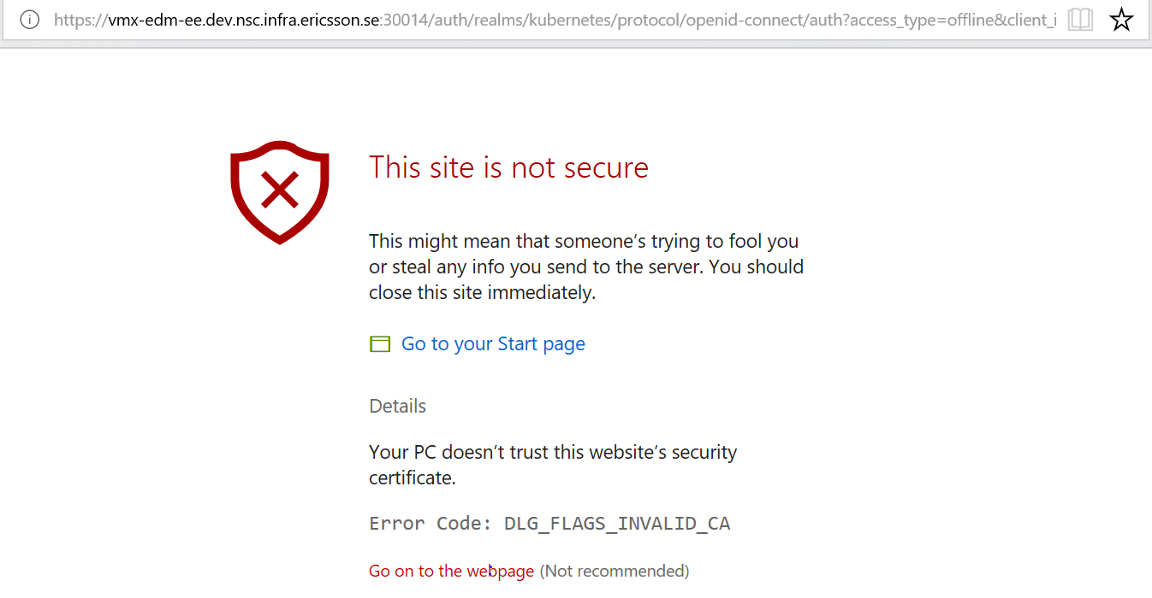
Authenticate yourself to execute Kubectl commands (Contd.)
The following steps will help you authenticate yourself in Kubernetes CLI using a Keycloak token.
Run the following command to set the path of the Kubernetes config file. Replace the value in <> with the actual file location.
$env:KUBECONFIG="<location of the config file>"
Run the kubelogin command (given below) to run the Kubelogin binary executable file.
.\kubelogin.exe
As shown below, click Details and then Go on to the webpage (Not recommended).
Enter your SIGNUM credentials.
After authentication, you will receive the response ‘OK’. Also, the Kubernetes config file will be updated with the ID token and Refresh token (shown in Fig: 5).
apiVersion: v1
clusters:
- cluster:
insecure-skip-tls-verify: true
server: https://<load balancer DNS>
name: <project-group>-cluster
contexts:
- context:
cluster: <project-group>-cluster
namespace: <your_deployed_namespace>
user: <kubectl_user_name>
name: <project-group>-context
current-context: <project-group>-context
kind: Config
preferences: {}
users:
- name: <kubectl_user_name>
user:
auth-provider:
config:
client-id: NSC_Platform
client-secret: 8768c5cd-de12-4fe2-94a8-a8e18ea61e53
id-token:jfhlasukdfjyasluifjajcjmdfasduilfaslufgaskljf
basjkfskjdfskjdfhlsjkdfhsljkdfasjkldfbsjkadfbasjkdfbasjkldfsajkdflasjkdfs
idp-certificate-authority: <location of the rootCA.pem file>
idp-issuer-url: https://sk1.eu-north-1.nsc.internal.ericsson.com:30088
refresh-token: dvsfgewsdfgdshsdgfe784gfasdhksdafh7oiufhjkasg
fdczvmnzbvnzweuhtrwettrafksjgdsfasdfgjasdhgfgsdajgkjashdfgkjhdfgkasdjhfgk
The Kubernetes config file updated with ID token and Refresh token
Back to index

Slide 35
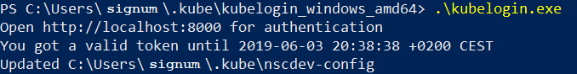
Authenticate yourself to execute Kubectl commands (Contd.)
The following steps will help you to authenticate yourself in Kubernetes CLI using a Keycloak token.
If you run the kubelogin command once again during the same day, you will receive a message saying that a valid token is available (as shown below). You can now execute kubectl commands.
Back to index

Slide 36
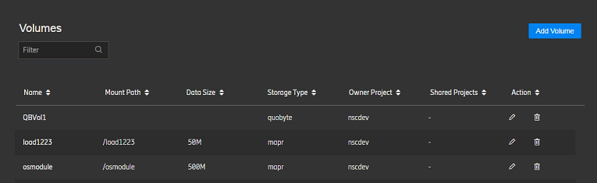
Access volumes
Volumes are the resources that hold your service and data. The following steps will help you access volumes available for your use.
Log on to the NSC platform as a User/Group Administrator.
Open the Volumes tab. View the volumes that have been assigned to you or shared with you.
As a User, you cannot add, edit, share, or delete a volume; the Add Volume button and the Action column will not be visible to you. Only a Group Administrator can perform these activities. To know your Group Administrator, view the attached Excel sheet in the My Support knowledge article.
Back to index

Slide 37
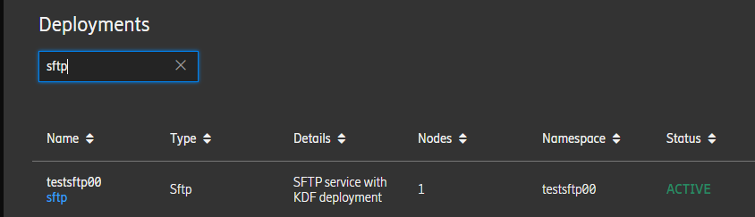
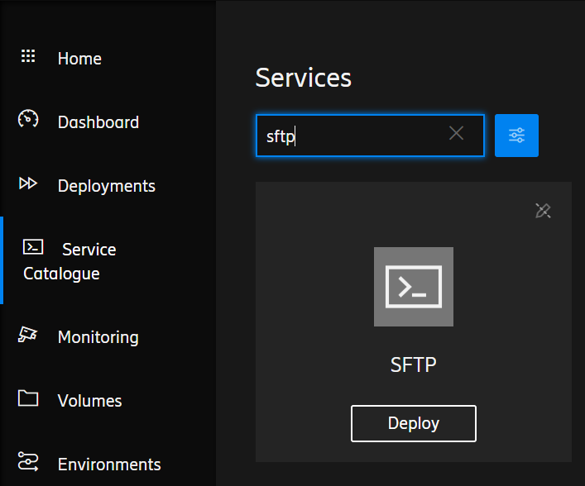
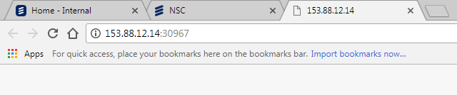
Ingesting data
To perform analytic activities using a service deployed, you need to ingest your data. Data can be ingested from Linux machine or from Windows machine. Before you ingest data, you need to perform the following steps.
Deploy the required service from the Service Catalogue tab.
To learn how to deploy a service, refer to the slide on Deploy an Existing Service.
After you have deployed the service, access the server link from the Deployments tab and note down the port number displayed in the address bar of the link.
Port number
Every deployment will have access only to the volume selected during its deployment.
The port number is unique for every deployment.
Back to index

Slide 38
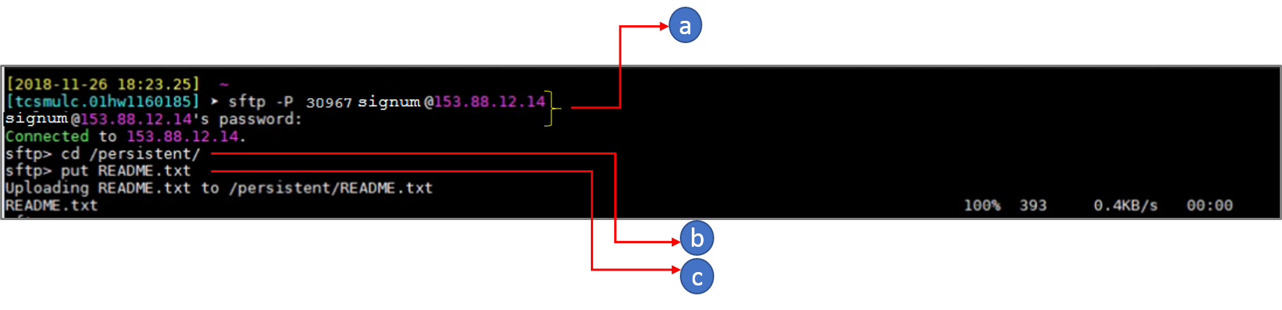
Ingesting data (contd.)
The following steps will help you ingest data from a Linux machine.
Ingest data from your Linux machine.
Log in to your sftp server with your credentials (SIGNUM and the password). Enter the port number you have noted down, while you log in.
Navigate to the persistent folder.
Ingest your data using put/mput/get command. In the following image, README.txt is the file containing the data.
Back to index

Slide 39
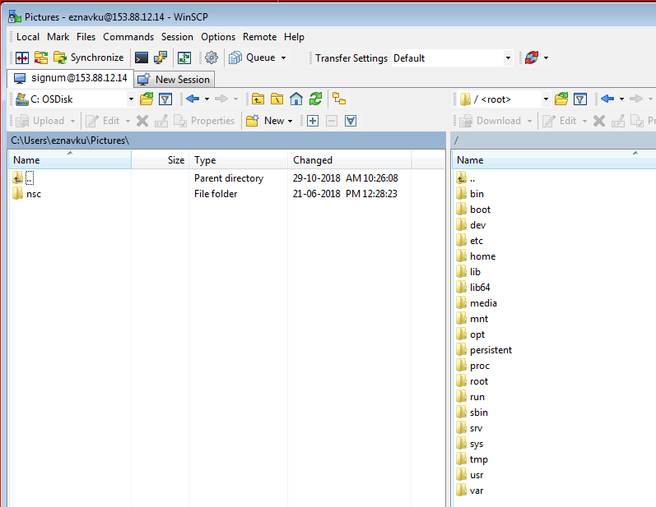
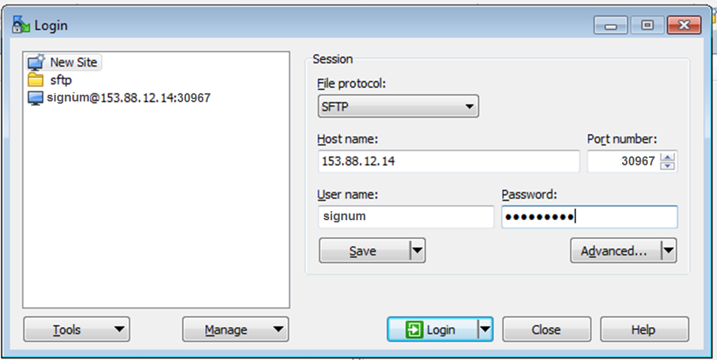
Ingesting data (contd.)
The following steps will help you ingest data from a Windows machine.
Ingest data from your Windows machine.
Launch a new Windows Secure Copy (WinSCP) session. Enter hostname (153.88.12.14), the port number you have noted down, your SIGNUM, and your password and then click Login.
Navigate to the persistent folder and drag and drop the files that need to be ingested.
Back to index

Slide 40
NSC platform administration

Slide 41
Section objectives
This section is intended only for the Group Administrators, who will need to facilitate User activities.
At the end of this topic, you will be able to:
Add a custom service
Configure images for a custom service
Create a manifest file to add a custom service
Create Helm charts to add a custom service
Deploy Helm charts from the CLI
Add environments
Add namespaces
Add PVCs within a namespace
Add volumes
Edit volumes
Share volumes with other groups
Add User Groups
Back to index

Slide 42
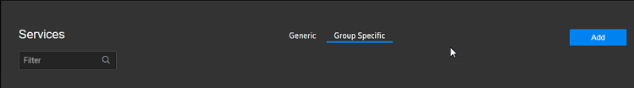
Add a custom service
The following procedure will help you add a custom service to Group Specific category in the NSC platform.
Configure images for the custom service you want to add. To view the procedure, refer to the slide Configure images for a Custom Service.
Create a manifest file or Helm charts for the custom service.
Log on to the NSC platform as a Group Administrator.
Navigate to the Service Catalogue tab on the left menu.
Under the Group Specific section, click Add.
Please move to the next slide for the next step in the procedure.
Back to index

Slide 43
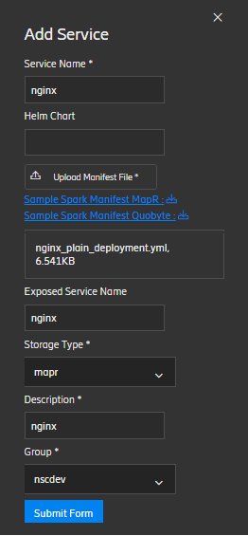
Add a custom service (contd.)
Add appropriate details and click Submit Form.
Enter a unique Service Name. Ensure that the name does not contain spaces or special characters.
If you are using Helm chart for your custom service, enter the name of the .tgz file in the Helm Chart field.
If you are using a manifest file for your custom service, click Upload Manifest File and select a Kubernetes manifest file.
In the Exposed Service Name field, enter the service name inside the manifest that should be exposed as link in the deployments. Leave this field blank if no service is to be exposed.
Select the Storage Type (mapr/quobyte) appropriate for your needs.
Enter a Description for the service.
In the Group field, select the group for which you are adding the service.
To learn more about Helm charts and how to use Helm charts for your custom service, refer to the slides on Create Helm Charts to Add a Custom Service.
For reference, download the sample manifest file available below this field and modify the file to suit your needs. To learn more about manifest files and how to modify the sample manifest file, refer to the slides on Create Manifest File to Add a Custom Service. To add a custom service, you can either use a manifest file or Helm charts.
While deploying two or more services, enter the names of the services separated by commas. There should be no space between the Exposed Service Names.
Exposed Service Name and Storage Type mentioned in the manifest file should be same as that mentioned in the fields.
Back to index

Slide 44
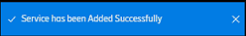
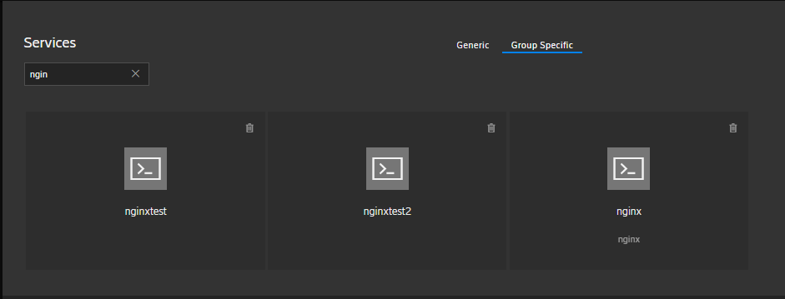
Add a custom service (contd.)
A message indicate successful onboarding of the service is displayed.
The service is ready for deployment now.
Back to index

Slide 45
Configure images for a custom service
Before you deploy a custom service, you need to configure images to NSC Docker registry and then add the custom service to the NSC platform. The following steps will help you configure images for a custom service.
Configure images to the Docker registry.
Create the following directory in your Linux machine.
# /etc/docker/certs.d/nsc-registry.infra.ericsson.se:5000/
Copy the domain.crt file to the below folder: (if you face any issue in downloading the .crt file, download the .txt file and then rename it with the extension .crt.)
#/etc/docker/certs.d/nsc-registry.infra.ericsson.se\:5000/"
Test if the certificate is working by pulling an example container image from the NSC Docker registry..
# docker pull nsc-registry.infra.ericsson.se:5000/nginx
Tag and push your custom image to the NSC Docker registry. In the following example, a public-available Ubuntu image with the name ubuntu is being pulled, tagged as testubuntu, and pushed into the NSC Docker registry. For a custom-built image, only tagging and pushing is needed.
# docker pull ubuntu
# docker tag ubuntu nsc-registry.infra.ericsson.se:5000/testubuntu
# docker push nsc-registry.infra.ericsson.se:5000/testubuntu
Add the custom service to the NSC platform and deploy.
For tips on configuring images and deploying services, refer to the General Instructions for Deployment slide.
You can use a manifest file or Helm charts to add a service. To learn how to add a custom service, refer to the slide Add a Custom Service.
Back to index

Slide 46
Create a manifest file to add a custom service
After you have configured images for a custom service, there are two ways to on board the custom service: manifest file and Helm charts.
What is a manifest file?
A manifest file (usually written in YAML) stores all information (including resource-related information) that Kubernetes requires to deploy and manage an application.
The information stored in a manifest file may include:
What images and containers to run
Which network ports to publish
How to scale the app (up or down as demand requires)
How to perform rolling updates
How to perform rollbacks
Resources are created in NSC in the sequence mentioned in the manifest file.
Back to index

Slide 47
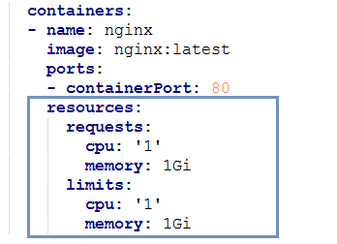
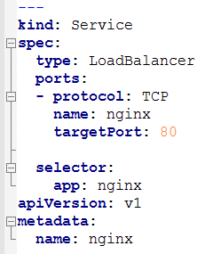
Create manifest file to add a custom service (contd.)
The following steps will help you modify the sample manifest file to meet your requirements. Sample manifest files are available in the Add Service form of NSC UI.
Specific resource requirements.
If you need to expose any service, specify the service name and targetPort.
Service section
NSC uses L4 ingress to expose services deployed on Kubernetes cluster. NSC e:OPS uses the manifest Service section (type: LoadBalancer) to generate Ingress link (IP:PORT) that you can expose or to access your deployed service.
Back to index

Slide 48
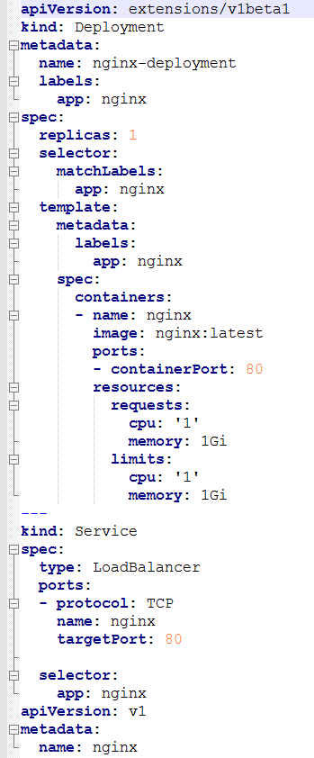
Create manifest file to add a custom service (contd.)
NSC also supports Nginx manifest. Nginx is an open source reverse proxy server, which can help you ensure efficient load balancing, improved performance, and excellent protection of user identities.
A sample Nginx manifest that works on NSC is shown here.
To learn more about Nginx, refer https://www.nginx.com/
Back to index

Slide 49
Create Helm charts to add a custom service
To onboard a custom service, Helm chart is an alternative way to manifest file.
What are Helm charts?
Helm charts are pre-packaged applications that can be deployed on Kubernetes.
Advantages of Helm charts
They help separate Kubernetes-specific variables such as namespaces, resource limits, labels, and persistent Disks from the application-specific variables. So, every time you need to add a service, you just need to specify the application-specific variables.
The application-specific details are very few as compared to Kubernetes-specific details; hence, formatting is easier.
For more information on Helm charts, refer the link https://docs.helm.sh/
Back to index

Slide 50
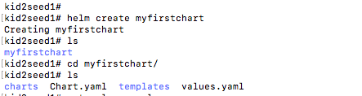
Create Helm charts to add a custom service (contd.)
The following steps will help you create Helm charts to add a custom service to the Group Specific category of services.
Create a helm chart (a directory) using Helm client.
The helm chart contains four files: charts.yaml, values.yaml, deployments.yaml, and service.yaml. A sample Helm chart will be provided by the NSC team.
Please move to the next slide for the next step in the procedure.
Back to index

Slide 51
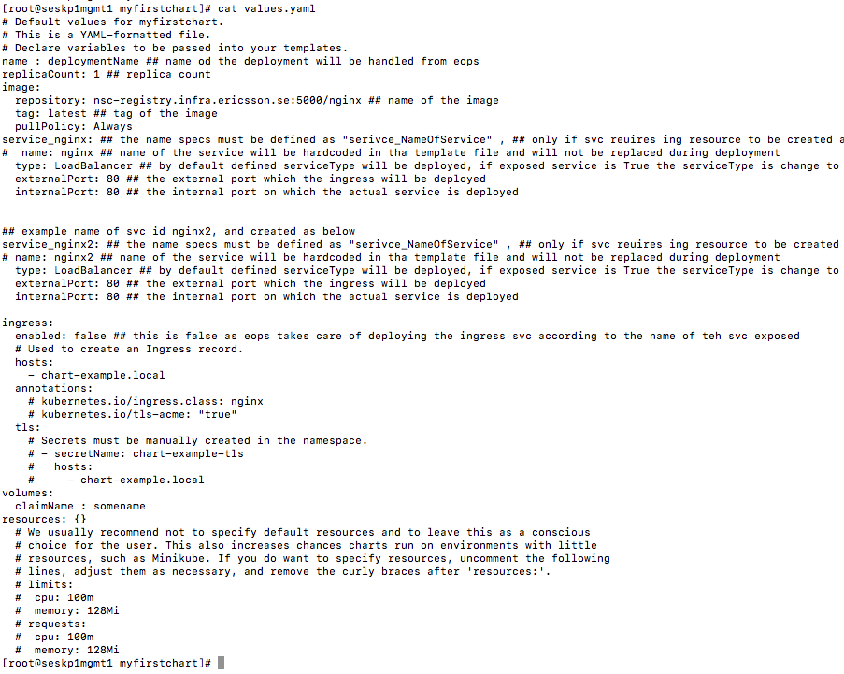
Create Helm charts to add a custom service (contd.)
Update the default values.yaml file (in the Helm chart directory) with application specific variables.
Enter the name of the image built for the application. In this example, the name is nginx.
Ensure that the pullPolicy is mentioned as Always.
Mention the specifications of the service as keyname in the format service_NameOfService. In this example, it is mentioned as service_nginx as nginx is the name of service here.
Mention the internal port on which the service runs inside the pod when the service is deployed. In this example, the port is 80.
Note that Ingress is disabled, by default (enabled: false). NSC enables it if necessary.
Mention the keyname volumes in the specifications.
If the volumes keyname is not mentioned, then no volume will be mounted for the service. In such a case, the name of volume to be mounted will be selected at the time of deployment in NSC UI.
In the values.yaml file, you can mention the resources for all the Kubernetes resource types that will be deployed through Helm charts. If the resources are not mentioned here, they can be specified inside the yaml file corresponding to each resource.
Back to index

Slide 52
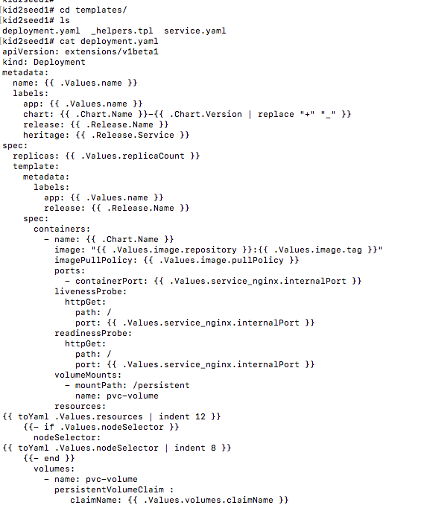
Create Helm charts to add a custom service (contd.)
Update the deployment.yaml file (in the Helm chart directory) with application specific variables.
Ensure that the name mentioned for app (Values.name) is same as that mentioned in the service.yaml file.
Read the service specifications from the keyname service_NameOfService in the values.yaml file through the deployment.yaml file.
In this example, the keyname is service_nginx,
because the service required to be exposed is nginx (service name mentioned as Exposed Service Name in NSC UI).
Mention the keyname volumeMounts in the spec.spec.containers specifications as mentioned here.
For every deployment, a Kubernetes Persistent Volume (PV) and a Persistent Volume Claim (PVC) will be created by NSC and will be attached to Helm deployment.
Add the keyname volumes in spec.spec specifications as mentioned here. This is a fixed value, which is read from values.yaml file through the deployment.yaml file.
Back to index

Slide 53
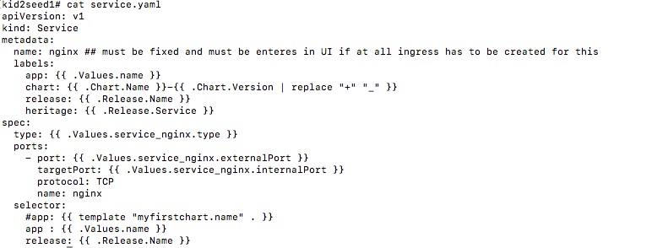
Create Helm charts to add a custom service (contd.)
Update the service.yaml file (in the Helm chart directory) with application specific variables.
Mention the service name (nginx) that needs to be exposed. This name should be specified as ‘Exposed Service Name’ in the NSC UI.
Ensure that the name mentioned for app (Values.name) is same as that mentioned in the deployment.yaml file.
Read the specifications of the service from service_NameOfService. For example service_nginx is the keyname that holds all the service-related specifications in the values.yaml file, because nginx is the name of the service here.
Ensure that the name mentioned for app (Values.name) is replicated in the deployment.yaml file as well.
Back to index

Slide 54
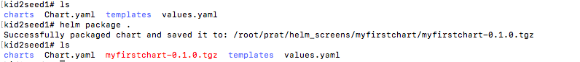
Create Helm charts to add a custom service (contd.)
Package your edited Helm chart in a .tgz file.
Push the chart to the Helm repo server using the following command.
Ensure that the Helm client is installed on your machine.
Once the chart is pushed, add the service to the Service Catalogue .
The application will be available for deployment in the NSC UI.
Name of the Helm chart
curl -X POST --data-binary “@myfirstchart-0.1.0.tgz” -H “username:signum” -H “filename:one” -H “password:password” –url https://nsc.infra.ericsson.se:8282/pushChart -k
SIGNUM ID
SIGNUM password
To add a service to the NSC Service Catalogue, refer to the slide Add a Custom Service.
To deploy a service, refer to the slide Deploy an Existing Service.
Back to index

Slide 55
Deploy Helm charts from the CLI
Why should I deploy my own Helm Charts?
It’s quick and easy to deploy Helm Charts from CLI, for someone who is well-acquainted with Helm commands.
Performing rolling updates on Helm Charts is easier from CLI, compared with doing this from the UI.
What do I need to deploy Helm Charts from CLI?
To deploy your own Helm Charts, you need to:
Create a namespace within an environment from the NSC UI. Within your environment’s namespace, you will have the privileges you need, to make and manage your CLI-based deployments.
To learn how to create an environment or a namespace, please read the blog: You are now empowered to create and manage Kubernetes resources.
Install the Helm client in your local machine.
For installation instructions, please read the blog: Helm chart: Kubernetes package manager
Back to index

Slide 56
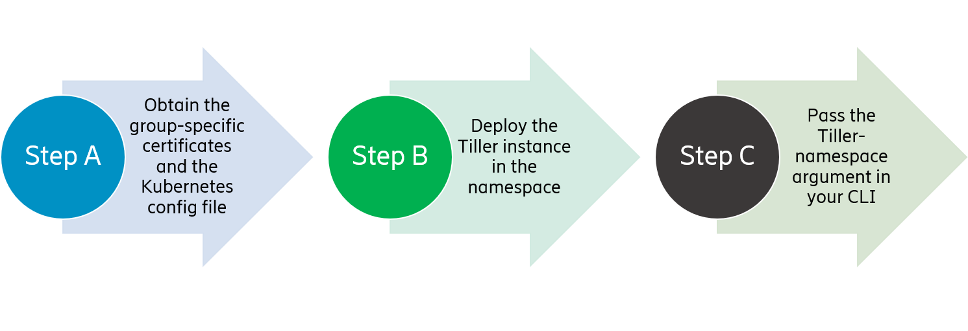
Deploy Helm charts from the CLI (contd.)
How do I deploy Helm Charts from CLI?
To deploy Helm Charts, you need to run the Tiller instance in your namespace. The Helm package consists of two parts: the client, which is simply called Helm, and the server, which is called Tiller. The Tiller typically runs inside your Kubernetes cluster.
The following graphic lists the key steps in deploying Helm Charts from CLI.
You can use a JFrog Artifactory to store your Helm charts. To get a repository created for you in the Artifactory, please write an email to us (nsc.team@ericsson.com). You can push Helm charts to the Artifactory or retrieve them from the Artifactory UI.
Back to index

Slide 57
Deploy Helm charts from the CLI (contd.)
Step A: Obtain the group-specific certificates and the Kubernetes config file. The certificates and the config file help NSC to authenticate you when you try to access the Kubernetes cluster and resources specific to your namespace.
To get access to the cluster,
Install the Chocolatey package manager, a package to automate software management, using the following command.
# Set-ExecutionPolicy Bypass -Scope Process -Force; iex ((New-Object System.Net.WebClient).DownloadString('https://chocolatey.org/install.ps1’))
Install the Kubernetes client (kubectl) using the following command. Kubectl is the CLI that allows you to run commands in Kubernetes clusters.
# choco install kubernetes-cli
The command prompt asks for your confirmation to run the script. Enter y.
Do you want to run the script?([Y]es/[N]o/[P]rint):Y
Run the kubectl version to check if it has been installed properly. If the version of kubectl client is displayed, it implies successful installation of the application.
# kubectl version
Change directory to the home folder.
# cd $HOME
Create a .kube folder.
# mkdir .kube
# cd .kube
Back to index

Slide 58
Deploy Helm charts from the CLI (contd.)
Step A: Obtain the group-specific certificates and the Kubernetes config file.
Copy <project_group>.crt and <project_group>.key files to the .kube folder, as illustrated below. This is used for authentication when you try to run the Tiller instance in your namespace. In the following example ‘nsc’ is the project group.
# cp nsc.crt nsc.key .kube/
Add the following entry in the hosts file (C:\Windows\System32\drivers\etc\hosts).
153.88.12.14 seskp1lb1.nsc.infra.ericsson.se
Create a “config” file in the .kube folder, using the “notepad config” command, and add the following lines to it. Replace the values within angle brackets <> with the real values.
apiVersion: v1
clusters:
- cluster:
insecure-skip-tls-verify: true
server: https://seskp1lb1.nsc.infra.ericsson.se
name: <project-group>-cluster
contexts:
- context:
cluster: <project-group>-cluster
namespace: <your_deployed_namespace>
user: <kubectl_user_name>
name: <project-group>-context
current-context: <project-group>-context
kind: Config
preferences: {}
users:
- name: <kubectl_user_name>
user:
client-certificate: <project-group>.crt
client-key: <project-group>.key
Back to index

Slide 59
Deploy Helm charts from the CLI (contd.)
Step B: Deploy the Tiller instance in the namespace.
A Tiller instance needs to be deployed in the namespace, so that you can connect to the Tiller server and execute Helm commands.
helm init --tiller-namespace=<user-namespace>
--override 'spec.template.spec.containers[0].resources.requests.cpu'="<Min>" --override 'spec.template.spec.containers[0].resources.limits.cpu'="<Max>"
--override 'spec.template.spec.containers[0].resources.requests.memory'="<Min>"
--override 'spec.template.spec.containers[0].resources.limits.memory'="<Max>"
Note: Replace the values within the angle brackets <> with real values. Replace <Min> and <Max> in the commands with the minimum and maximum resource (CPU and memory) limit applicable for the tiller deployment in the namespace.
Step C: Pass the tiller-namespace argument in your CLI to execute all the helm commands.
Execute the following command from your CLI. Replace the values within angle brackets <> with real values.
helm install <deployment.tar> --tiller-namespace=<tiller instance in your namespace>
You can now deploy, delete, and modify Helm Charts from CLI. For example, you can use the following command to delete Helm Charts.
helm delete <chart> --purge --tiller-namespace=<user-namespace>
Back to index

Slide 60
Add environments
To build, test, and deploy your custom service, you need the right platform and infrastructure. To perform these activities for your custom service, you might have independent or overlapping teams, needing their own separate environments. Effective access management is the key to track the service features needed for each of the teams and their environments.
What are NSC environments?
NSC environments control user access to runtime (namespaces) and storage (volumes); this is achieved using User Groups. An NSC environment is associated with, or owned by, a User Group. All environment namespaces are accessed only by the User Group associated with the Environment. Similarly, all volumes associated with an Environment can be accessed only by the User Group associated with the Environment. While adding a new volume, you need to specify the environment associated with it.
An NSC Group Administrator can create one or more environments for an NSC Group and associate a User Group with each environment. Then namespaces can be created within the environments and volumes associated with it. Members of an environment’s User Group are granted extended privileges within the environment’s namespaces. To learn how to create a namespace, refer to the slide Add Namespaces.
Why do I need extended privileges on the namespaces?
NSC introduced the feature ‘Environments’ to fulfill users’ need for better control over namespaces and resources. If a job executed using a service deployment fails, you may want to analyze why it failed and resolve it, if possible. To be able to do these activities, you need advanced privileges over namespaces and resources.
Back to index

Slide 61
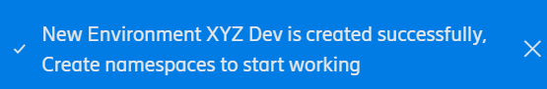
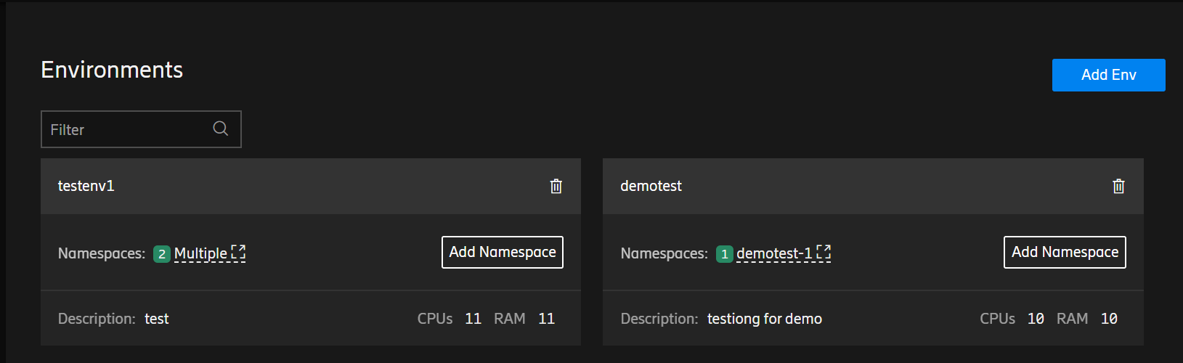
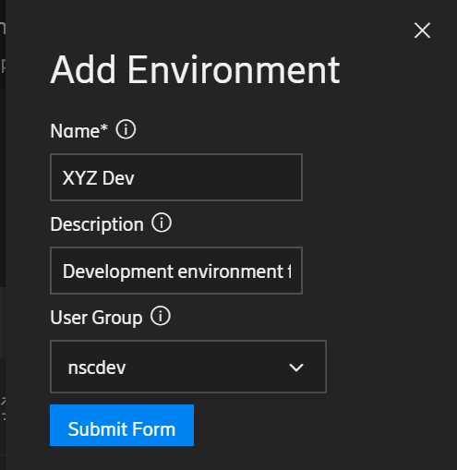
Add environments (contd.)
As a Group Administrator, you can add an environment for your group by performing the following steps.
Log on to the NSC platform as a Group Administrator.
Navigate to the Environments tab on left menu and click Add Env.
In the Add Environment window, fill in the details and click Submit Form.
In the Name field, enter a unique name for your environment.
In the Description field, enter a description or purpose for your environment.
In the User Group field, select the user group with which you want to associate the environment.
The environment has been created successfully.
Back to index

Slide 62
Add namespaces
You will be able to build, test, and deploy your service using extended privileges within an environment’s namespace. To learn about environments, refer to the slide Add Environments.
How is an environment’s namespace different from that of a namespace created as part of a Generic service deployment?
When you deploy a service, a Kubernetes namespace and the associated resources are created. You run your analytical jobs using the resources in the namespace.
For a service deployment made from the NSC user interface (UI), the service’s lifecycle is managed by NSC’s management software, e:OPS. As a result, you can only view the resources deployed in this namespace.
For a service deployment made using an environment, the service’s lifecycle is managed by you, using the environment’s namespaces. As a result, you have extended privileges (to create, view, edit, and delete) on Kubernetes resources within the namespace. The resources include Configmaps, Secrets, Services, Deployments, Stateful sets, Replica sets, Replication Controllers, and Pods. So, if your deployment is in the NSC ‘Spawning’ state for a long time, or if your service is unable to execute a job, you can debug the problems yourself with the namespace extended privileges associated with the deployment. This will not be possible for a deployment made from the NSC UI.
However, even for a service deployment made using an environment, you have restricted access to the system configuration resources such as namespace, Persistent Volume Claims (PVC), Persistent Volumes (PV), resource quota, roles, role bindings, and service accounts. These configuration resource restrictions are essential to effectively manage the NSC multi-tenant platform.
Back to index

Slide 63
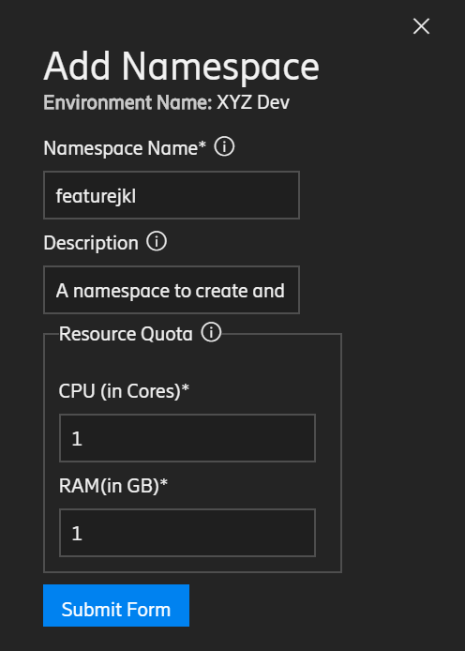
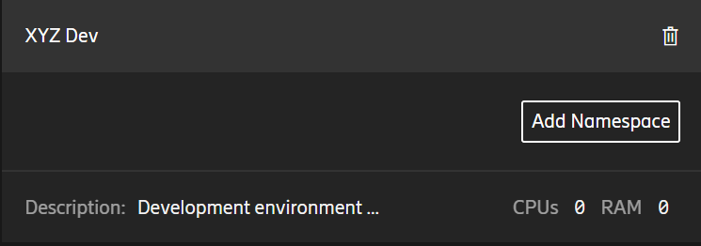

Add namespaces (contd.)
As a Group Administrator, you can add a namespace within an environment by performing the following steps.
Log on to the NSC platform as a Group Administrator.
Navigate to the Environments tab on the left menu.
Identify the environment in which you want to create a namespace. Click Add Namespace.
In the Add Namespace window, fill in the details and click Submit Form.
In the Namespace Name field, enter a unique name for the namespace.
In the Description field, enter the purpose for which the namespace is being created.
In the Resource Quota fields, specify the CPU and RAM capacity you will need for your activities.
The namespace has been created successfully.
The namespace is created successfully.
To learn how to add a persistent volume claim (PVC) within a namespace, refer to the slide Add PVCs within a Namespace. To learn about volumes, PVs, and PVCs, refer to the slide Add Volumes.
Back to index

Slide 64
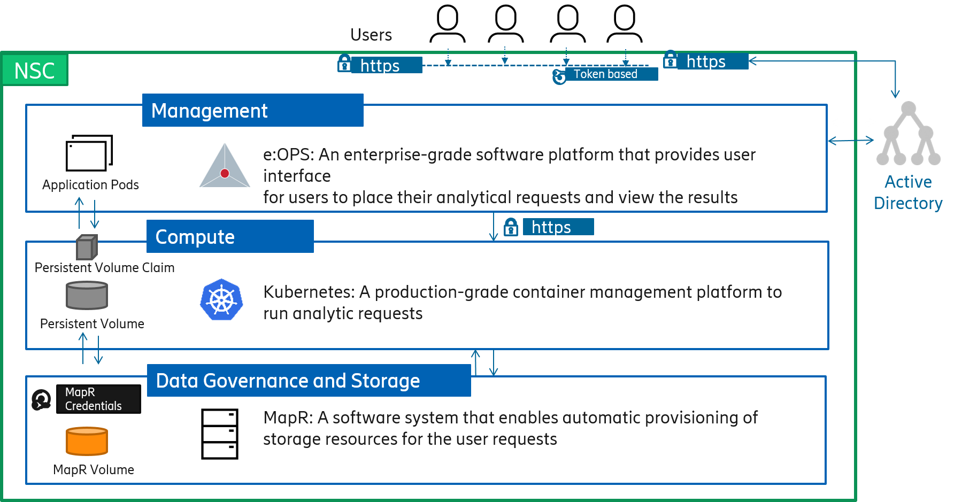
Add volumes
What are volumes?
MapR volumes (in NSC’s data and storage layer) are used to store all data relevant to your analytical activities. You can connect to the data and storage layer only through the compute layer, managed by Kubernetes (the software used for deploying applications). The selected MapR volume is mounted in the Kubernetes pod at the path /persistent for generic services. The volume is mounted at the path /persistent-<volume name> for custom services because you can use multiple volumes for custom services. For example, if your volume name is ‘testdata’, then the persistent folder path will be /persistent-testdata. To learn more about this feature, please read our blog Freedom to use multiple volumes for custom services.
The /persistent folder is called the persistent volume (PV) and you can access this folder using your MapR (SIGNUM) credentials. Any data added to this path persists in the MapR volume.
The following graphic explains how volumes, PVs and PVCs are accessed.
How does a service access a volume?
The application pods in the management layer should be able to access the PV in the Kubernetes layer to read data from the MapR volume, or to write data to the volume. To facilitate this, a persistent volume claim (PVC) is created at the management layer and is mounted at the path where the PV is mounted. This enables Kubernetes pods to directly store data or the application state in the PV. To learn how to add a PVC within a namespace, refer to the slide Add PVCs within a namespace.
Back to index

Slide 65



Add volumes (contd.)
The following steps will help you access the volumes available for your use and also add a volume.
Log on to the NSC platform as a Group Administrator.
Open the Volumes tab on the left menu.
On the Volumes tab, click Add Volume.
In the Add Volumes window, fill in the required details and click Submit Form.
Enter an appropriate Volume Name.
Select the appropriate Storage Type for the volume you want to add.
Specify the Volume Size in MB/GB.
Select the environment for which the volume should be available.
Select RW as the Volume Type.
RW is the only option available so
that you can read and write data
to the new volume.
Enable/disable encryption for your volume in the Volume Encryption field.
The volume has been added successfully.
The only option available for Volume Type is RW (Read and Write)
so that you can read and write data to the new volume.
Back to index

Slide 66


Edit and share volumes
As a Group Administrator, you might want to share a volume with other projects/groups. The following steps will help you edit/share your volumes.
Log on to the NSC platform as a Group Administrator.
Navigate to the Volumes tab on the left menu.
The volumes accessible to you are listed. Corresponding to the volume that you want to edit or share, under the Actions column, click the Edit button.
Make changes in the fields, as required. Click Submit Form.
Modify Volume Size to increase or decrease volume.
Choose one or more Shared Environments for the volume.
Modify Number of Replicas to achieve the desired redundancy.
Modify the duration by which you want the volume to time out.
Change the Volume Type to provide only necessary access to the shared group. The Volume Type R refers to read-only access to the volume whereas RW refers to read and write access to the volume.
For a Quobyte volume, you can
only choose a Shared Group; you
cannot modify any other parameters.
Group Administrators or Users of the project with whom a volume is
shared can only view the volume but cannot edit or delete the
volume.
Back to index

Slide 67


Edit and share volumes (contd.)
The volume has been edited successfully.
The environments with which the volume has been shared are displayed in the Shared Environments column, corresponding to the volume.
Back to index

Slide 68




Add PVCs within a namespace
To enable Kubernetes pods directly store data or the application state in the PV, a persistent volume claim (PVC) is created at the management layer and is mounted at the path where the PV is mounted. To create a PVC for your namespace, perform the following steps.
On the Environments tab, identify the environment and click the namespace corresponding to which you want to add a new PVC.
Corresponding to the required namespace, in the PVC column, click + Add.
In the Add PVC window, fill in the details and click Submit Form.
Enter a unique name for the PVC.
Select the MapR Volume whose storage capacity you want to use for the PVC.
Select your UnixId.
Enter your SIGNUM credentials.
The PVC has been created successfully.
To learn more about volumes, PVs and PVCs, refer to the slide Add volumes.
Back to index

Slide 69
Add user groups
An NSC User Group is used to grant or restrict access to an environment’s resources such as namespaces, PVCs, and volumes associated with the environment.
An NSC User Group comprises team members who can belong to one of the two roles: Group Administrators and Users. Described at a high level, Group Administrators manage group-level resources, while Users consume resources. For example, Group Administrators can create environments, namespaces, volumes, Persistent Volume Claims (PVCs) and deployments. Users can also create deployments, but not volumes or namespaces. Users can only view or use volumes or namespaces created by Group Administrators.
To learn more about environments and namespaces, please refer to the slide Add Environments.
A project has one IDM role for Group Administrators, and multiple IDM roles for users — one per User Group. The registration methods for these roles are described below:
NSC registers the Group Administrator IDM role when a project is onboarded.
NSC registers the User IDM roles (AD group), when Group Administrators create User Groups in the NSC platform.
When a user logs into NSC, the user’s group and role are determined by the user’s registered IDM role.
The IDM role lifecycle and user-role association are managed by the project using the IDM portal. This implies that the projects determine the users and their roles for NSC access.
Back to index

Slide 70

Add user groups (contd.)
An NSC user can be part of one or more user groups. For example, if you are the project manager of your project, then you can create multiple IDM roles: Role A for administrators and Role X, Y, and Z for users.
To acquire an IDM role that is part of an AD group, please follow the steps B and C in the blog Onboarding NSC users.
Back to index

Slide 71


Add user groups (contd.)
Registering Group Administrators
Registering User Groups
To onboard an NSC project, you need an Administrator IDM role. In the My Support & Services portal, when you request NSC access for our project group, you need to specify one or more SIGNUMs (with Administrator IDM role) as the Group Administrator(s). Then, NSC will register the specified SIGNUMs as the Group Administrator(s) for your project (NSC Group). When the service request is completed, an NSC Group is created and the Group Administrator(s) are registered.
After an NSC Group is created, users with the Administrator IDM role can log on to NSC as Group Administrators of this Group.
An NSC Group can have one or more User Groups. User Groups are used to manage access to environments.
A user belonging to a User Group can access the environment owned by the User Group. User Groups are managed using IDM roles. When a Group Administrator creates a new NSC User Group, an IDM role must be associated with it. NSC will register this role as the user role for all users in this NSC Group.
After a User Group is created, users who possess the IDM role associated with the User Group can log on to NSC as Users and access environments owned by the User Group.
Back to index

Slide 72



Add user groups (contd.)
After you have registered User Groups in the IDM portal, the only activity left is to add an NSC User Group corresponding to the IDM User Group.
As a Group Administrator, you can add user groups by performing the following steps.
Log on to the NSC platform as a Group Administrator.
Navigate to the User Groups tab on the left menu.
Click Add User Group.
In the Add User Group window, fill in the details and click Submit.
Enter the AD group name that should be associated with the User Group.
Enter a description explaining the User Group’s purpose.
Enter the AD Group ID corresponding to the User Group Name.
The new User Group has been added successfully.
If you
create an environment associated with this User Group, then the members of this User Group will have access to the environments and the associated resources such as namespaces, PVCs, and the volumes
Back to index

Slide 73
FAQs

Slide 74
Frequently asked questions
Does NSC support Cloudera?
Cloudera does not support containers yet; however, it is working on a setup to separate compute and storage, using HDFS and S3 as the interfaces in-between. It is using VMs as an interim solution. Cloudera is expected to support container infrastructure from 2019.
Can we get demo access of the NSC platform?
No, there is no trial access to the NSC platform. You need to request for the service using the My Support portal. Please refer to the blog Onboarding NSC users to learn how to acquire NSC platform access.
Does NSC support Hive?
NSC does not natively support framework like Hive, as these frameworks are dependent on data location. In NSC architecture, compute and data storage are handled independently. However, MapR is coming up with a Kubernetes edition of their whole stack, including Hive, which will run on NSC from Q1, 2019 (tentative).
Back to index

Slide 75
Frequently asked questions (contd.)
Can a user create a group-specific Service?
No. We have two user roles who can access the NSC platform from a project group: User and Group Administrator. Users, who are the users of a project group, can deploy services and edit deployments that they made, whereas Group Administrators can add users to a project group, create services, and make deployments in addition to User activities.
Can I run HDFS commands in the deployed pod?
Yes, MapR client tools are installed in the PACC container and hence, your can run the HDFS commands supported by MapR-FS. To understand the differences between HDFS and MapR-FS, refer the following link
https://mapr.com/blog/mapr-fs-vs-hdfs-5-minute-guide-understanding-their-differences-whiteboard-walkthrough/
Is there a maximum or minimum limit for resources (CPU and RAM), while deploying a service?
Each worker node deployment should have a minimum of 1 vCPU and 1GB RAM and can have a maximum of 6 vCPU and 54GB RAM.
Back to index

Slide 76
Glossary

Slide 77
Glossary
Term | Definition
Analytics-as-a-Service | A model by which analytical computations are offered as a service over cloud
Bare-metal cluster | A computer server that supports only one tenant
Cloud | A method of accessing computers, information technology (IT), and software applications through a network connection (WAN/Internet)
Clustered File System | A file system that can be run on multiple servers but can be accessed and managed as one system
Container | An isolated user-space instance within a computer that acts as a computer, by itself
Distributed File System | A file system that stores data on a server
Docker | A program that is used to create application containers and for running code packaged in containers
File System (FS) | A set of rules that defines how data is stored, accessed and managed on a storage system such as Hard Disk Drive (HDD)
Kubectl | A Command Line Interface (CLI) tool used to run commands and manage clusters in Kubernetes
Kubernetes | A software system that is used for automatic deployment, scaling, and management of containerized applications
MapR | A software that provides access to variety of data sources from a single computer cluster
Back to index

Slide 78
Glossary
Term | Definition
MapR Persistent Application Client Container (PACC) | A component of MapR that supports containerization of existing and new applications by providing containers with persistent data access from anywhere
Namespace | A programming entity that is used to uniquely identify a set of names so that there is no ambiguity when two or more objects with the same name but different entities are mixed
Node | A point where networking devices connect or intersect in a network
Persistent Volume (PV) | A folder in the compute layer to enable the application/service access data in a MapR volume, available in the data and storage layer.
Persistent Volume Claim (PVC) | A folder in the management layer to enable Kubernetes pods to store data or application status in a PV (available in the compute layer).
Throughput | The amount of data processed by a computer within a given time
Windows Secure Copy (WinSCP) | A free and open-source file transfer client for Windows operating system
Back to index

Slide 79
Appendix

Slide 80
NSC generic service offerings
In the following table, the NSC Generic Service offerings with their descriptions have been grouped based on the framework category.
Framework Category | Service Name | Suggested Configuration | Description
Analytic Frameworks | Sparkv [v 2.3.0] | 1 CPU, 4GB RAM | A unified analytics engine for large-scale data processing
 | Rsparklyr [v 3.5.1] | 1 CPU, 4GB RAM | An R package that lets you data in Spark while using familiar tools in R
 | Apache Flink [v 1.4.2] | 1 CPU, 4GB RAM | A stream processing framework for distributed, high-performing, and accurate data streaming applications
 | Apache Kafka [v 1.1.0] | 1 CPU, 4GB RAM | A distributed streaming platform that provides low-latency, high-throughput, fault-tolerant publish and subscribe pipelines and is able to process streams of events
 | Apache Drill [v 1.13.0] | 1 CPU, 4GB RAM | A schema-free SQL query engine for Hadoop, NoSQL, and cloud storage
 | Elasticsearch [v 6.3.0] with Logstash and Kibana | 1 CPU, 4GB RAM | An open-source full-text search and analytics engine
 | Tensorflow [v 1.6] | 1 CPU, 4GB RAM | An open-source machine learning framework used for numerical computation using data flow graphs
 | RStack (Includes Rserver- 3.2.3 , Rstudio- 1.1, RShiny -1.5, spark-2.3, Anaconda Jupyter( Anaconda 5.2 with Python 2.7)) | 2 CPU, 8GB RAM | A group of packages (including RStudio, RShiny along with Jupyter notebook with Anaconda and Spark) that provide Integrated Development Environment (IDE) for R, thereby enabling faster statistical analysis of data
Configuration suggested for each service in the above table indicate the minimal requirements to run the service. Users may need to set the appropriate configuration for a service based on the service’s resource need.
Back to index

Slide 81
NSC generic service offerings (contd.)
In the following table, the NSC Generic Service offerings with their descriptions have been grouped based on the framework category.
Framework Category | Service Name | Suggested Configuration | Description
Analytic Frameworks | Apache Beam V 2.8 with Flink V 1.6.2 | 2 CPU, 4GB RAM | A unified tool that will help you define dataflow pipelines to process data in batches and in streams
 | Apache NiFi V 1.8.0 | 2 CPU, 4GB RAM | A software product that automates the flow of data between systems
 | StreamSets Data Collector (SDC) V 3.7.1 | 4 CPU, 4GB RAM | A unified tool that will help you define dataflow pipelines to process data in batches and in streams
Databases | Postgres [v 10.4] | 1 CPU, 2GB RAM | An object-relational database
 | MongoDB [v 3.6.5] | 1 CPU, 4GB RAM | A NoSQL database using JSON-like documents with schemas
 | Cassandra [v 3.11.3] | 1 CPU, 10GB RAM | A distributed NoSQL database
 | Redis [v 4.0.9] | 1 CPU, 4GB RAM | An in-memory database with a distributed, in-memory key value store
Others | SFTP (Available only for MapR storage) | 1 CPU, 2GB RAM | A method to ingest data through CAS/ECA
 | Jupyter Note book [v 5.5.0] with Spark [v 2.3.0] | 1 CPU, 4GB RAM | A web application that allows you to create and share documents containing live code, equations, visualizations, and text
 | Prometheus [v 2.3.0] | 1 CPU, 4GB RAM | A monitoring and alerting system
The configuration suggested for each service in the above table indicate the minimal requirements to run the service. Users may need to set the appropriate configuration for a service based on the service’s resource need.
If you would like any service to be added to the Generic Services category of the NSC platform, contact nsc.team@ericsson.com.
Back to index

Slide 82
Generic service offerings certification checklist
The following activities acquire NSC Certification for a service onboarded in the Generic services category:
Checklist for Analytic and Database Service Catalog
Verify that the service is up and running in all the pods.
If the service is based on master/slave architecture, then ensure that every slave is reporting to master all the time.
If the service is shutdown accidently because of any reason, ensure that the service automatically starts within a specific time interval.
Verify that the actual service running port is exposed properly and is accessible through Ingress link or port number.
Verify that MapR / Quobyte mount is consistent for the service.
Verify that the service is working as expected with sample data set (~1 TB).
Additional Checklist Specific for Database Service Catalog
Verify that the service is pointing to persistent location (MapR/Quobyte) as the data directory location.
Verify that users are able to insert and execute queries from the database (sample dataset).
Back to index

Slide 83
Third party NSC components
The following table lists the third party NSC components.
Component Name | Description
MapR [v 6.0.0] | A software that provides access to variety of data sources from a single computer cluster
ECCD (Kubernetes [v 1.9.6]) | A software system that is used for automatic deployment, scaling, and management of containerized applications
Back to index

Slide 84
General instructions for deployment
To successfully build container images and deploy services, use the following guidelines:
Build images as small as possible.
Tune resource (CPU, Memory) requests in the manifest file according to the application needs.
Include only the required details (avoid PACC images for applications which do not need MapR access) in the manifest.
Delete unused images (test images) from the registry.
Remove obsolete deployments from the platform.
Back to index

Slide 85
Load balancer IP and DNS
Location | Load Balancer IP | Load balancer DNS
Sköndal , Sweden | 153.88.12.14 | seskp1lb1.nsc.infra.ericsson.se
Chennai, India | 130.100.144.48 | 130.100.144.34:6443
Back to index

Slide 86
Troubleshooting, Help and Support

Slide 87
Help and support
If you are unable to perform any activity in the NSC platform UI (e:OPS), clear the cache in your browser and perform the activity once again. If the issue persists, then raise an incident in the My Support portal. For any support-related information, please read the blog Where do I go for help
If you need to onboard your team or yourself to the NSC platform, please read the Onboarding NSC users blog.
If you need the files<project_group>.crt and <project_group>.key to access the deployed container, deploy the SFTP service and copy the .key and .crt files from the /Persistent folder. While deploying the service, make sure you select the volume with your group name. For detailed steps to access the /Persistent folder, refer to the slides on Ingest Data.
Back to index

Slide 88
Revision history
User Guide Version | Date Modified | Slides Modified | Key Changes in the Modified Slides
1.0 | 22-Jun-2018 | All (Created the presentation)
1.1 | 29-Jun-2018 | 2, 18, 19, 26, 27, 33, 34, 37, 38, 39 | 2 – Access-related prerequisites updated 18 - Steps and screenshots updated for the new field MapR Volumes added in the Deploy Service dialog box of NSC portal, Deployment parameters for KDF services added 19 - Screenshots updated in continuation with the changes in slide 18 26 – Sample Manifest File updated based on deployment parameters for KDF services 27 Screenshot updated for the new column Storage Type on the Volumes tab of NSC portal 33 - Steps and screenshot updated for the new field Storage Type added in the Add Service dialog box of NSC portal 34 - Screenshots updated in continuation with the changes in slide 33 37 - Steps and screenshots updated for the new field Storage Type added in the Add Volumes dialog box of NSC portal 38, 39 - Screenshots updated for the new column Storage Type on the Volumes tab of NSC portal
Back to index

Slide 89
Revision history (contd.)
User Guide Version | Date Modified | Slides Modified | Key Changes in the Modified Slides
1.2 | 19-Jul-2018 | 36, 51, 17, 18, 19, 31, 32, 37 | 36 – Sample manifest file added 51 – New Generic Services added 17, 19, 31, 32, 37 – Notes added 18 – Screenshots and steps updated according to latest screens
1.3 | 16-Aug-2018 | 52, 53, 54 | 2 – Prerequisites updated 53, 54 – Service versions updated 55 – A slide on Generic Service offerings Certification checklist added 56 – A slide on third party components added 59 – Troubleshooting step added
1.4 | 31-Aug-2018 | 18, 41 to 43, 44 to 49, 22, 60 | 18 – Screenshot and content updated according to the latest deployment 41 to 43 – Manifest file-related content added 44 to 49 – Helm chart-related content added 22 – Note on adding a generic service removed 64- Note on adding a generic service added
1.5 | 12-Sep-2018 | 19 | 21 – A slide on deployment parameters added
1.6 | 18-Feb-2019 | 18, 62 | 18 – A note to explain the “Service Password” field added 62 – New services (NiFi, Beam, SDC) added to the Generic Services list

Slide 90
Revision history (contd.)
User Guide Version | Date Modified | Slides Modified | Key Changes in the Modified Slides
1.7 | 10-Apr-2018 | 17, 21 | 17 – The View Manifest feature for generic services explained 21 – The multiple MapR volume mount feature for custom services added
2.0 | 06-May-2019 | 49-57 | Added slides and updated content with respect to the new feature ‘Environment’
Back to index

